Slide 1
Creating Customized Tables:
Microdata Access Tool in data.census.gov
Southern Demographic Association
October 18, 2022
Ron Williams
Center for Enterprise Dissemination
Dissemination Outreach Branch
U.S. Census Bureau

Slide 2
Outline
Microdata Access Basics
Microdata Access Demo
Questions

Slide 3
What is Public Use Microdata?
Public Use Microdata
Anonymized
No personally identifiable information
Edits to protect confidentiality
Accessible
data.census.gov/mdat
Application Programming Interface (API)
Download through FTP sites
Individual Responses
Must be tabulated and weighted by user

Slide 4

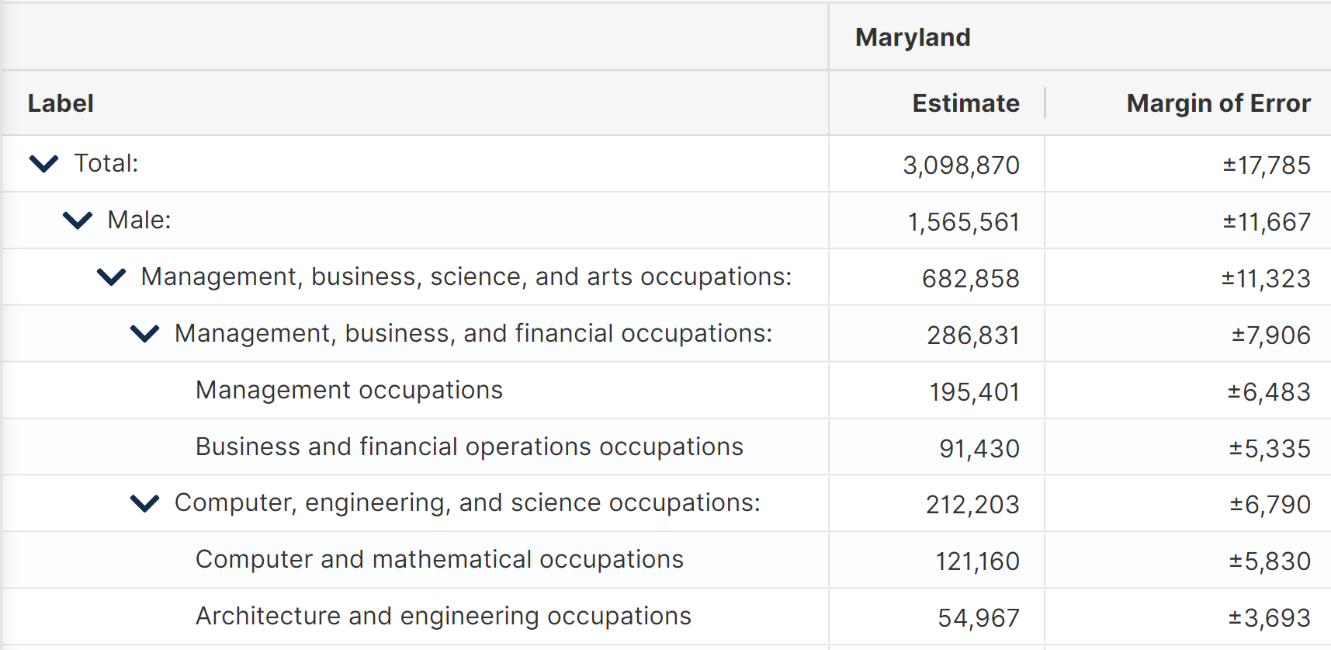

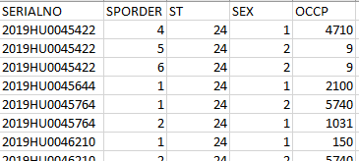
Tabulated Data vs. Microdata:
What’s the Difference?
data.census.gov
Aggregated tables for a geography:
“In 2019 in Maryland, approximately 121,160 males worked in computer and mathematical occupations.”
Tabulated data
Microdata Access Tool (MDAT)
Microdata (a set of edited survey responses):
“This male in Maryland is a web developer.”
Microdata

Slide 5
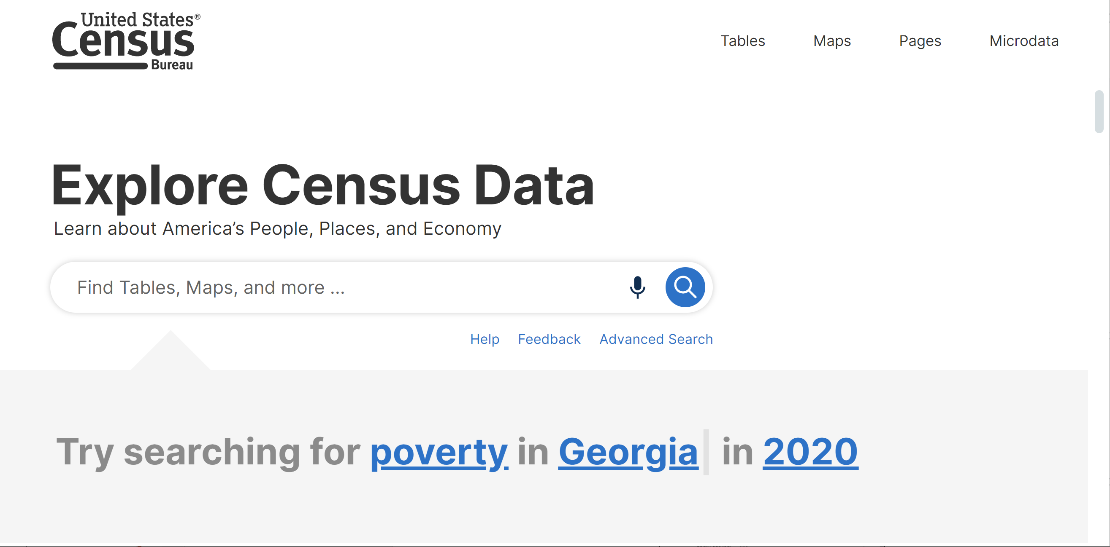
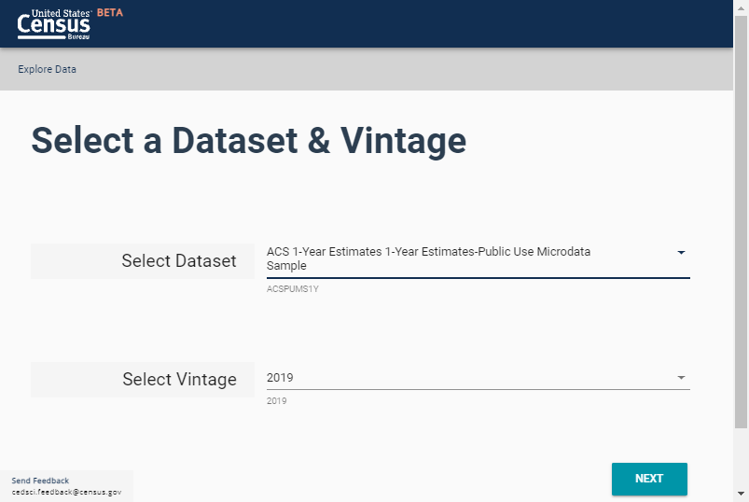
Data.census.gov vs Microdata Access Tool
data.census.gov
Provides pre-tabulated tables
More geographic detail, less topic detail
More precise data
Internal File
Microdata Access Tool (MDAT)
Provides access to create custom tables
More topic detail, less geographic detail
Public Use File

Slide 6
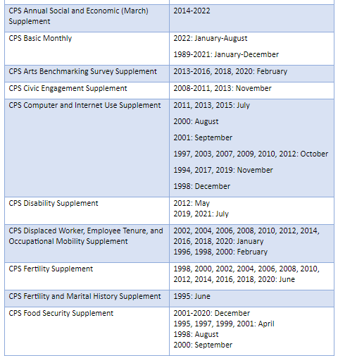
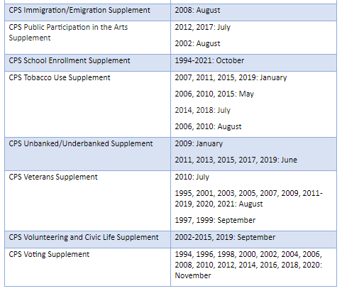
Surveys in the Microdata Access Tool
American Community Survey (ACS)
Current Population Survey (CPS)
Dataset | Vintage
ACS 1-Year Estimates - Public Use Microdata Sample | 2004-2019
ACS 1-Year Estimates - Puerto Rico Public Use Microdata Sample | 2005-2019
ACS 5-Year Estimates - Public Use Microdata Sample | 2009-2020
ACS 5-Year Estimates - Puerto Rico Public Use Microdata Sample | 2009-2020
census.gov/data/what-is-data-census-gov/guidance-for-data-users/transition-from-dataferrett.html

Slide 7
Available Geographies
ACS Available Geographies
Nation
Region
Division
State
Public Use Microdata Area (PUMA)
CPS Available Geographies
Nation
State
Selected Counties (in CPS ASEC)

Slide 8
Microdata Access Demo
Select Variables and Geographies, Limit Universe, Define Table Layout, and Save Results
    Sex by Disability Status for the Population without Health Insurance in Texas from the CPS ASEC
Recode Continuous Variables and Select PUMAs
    Poverty Status by Single Year of Age in Baltimore city PUMAs based on the ACS

Slide 9
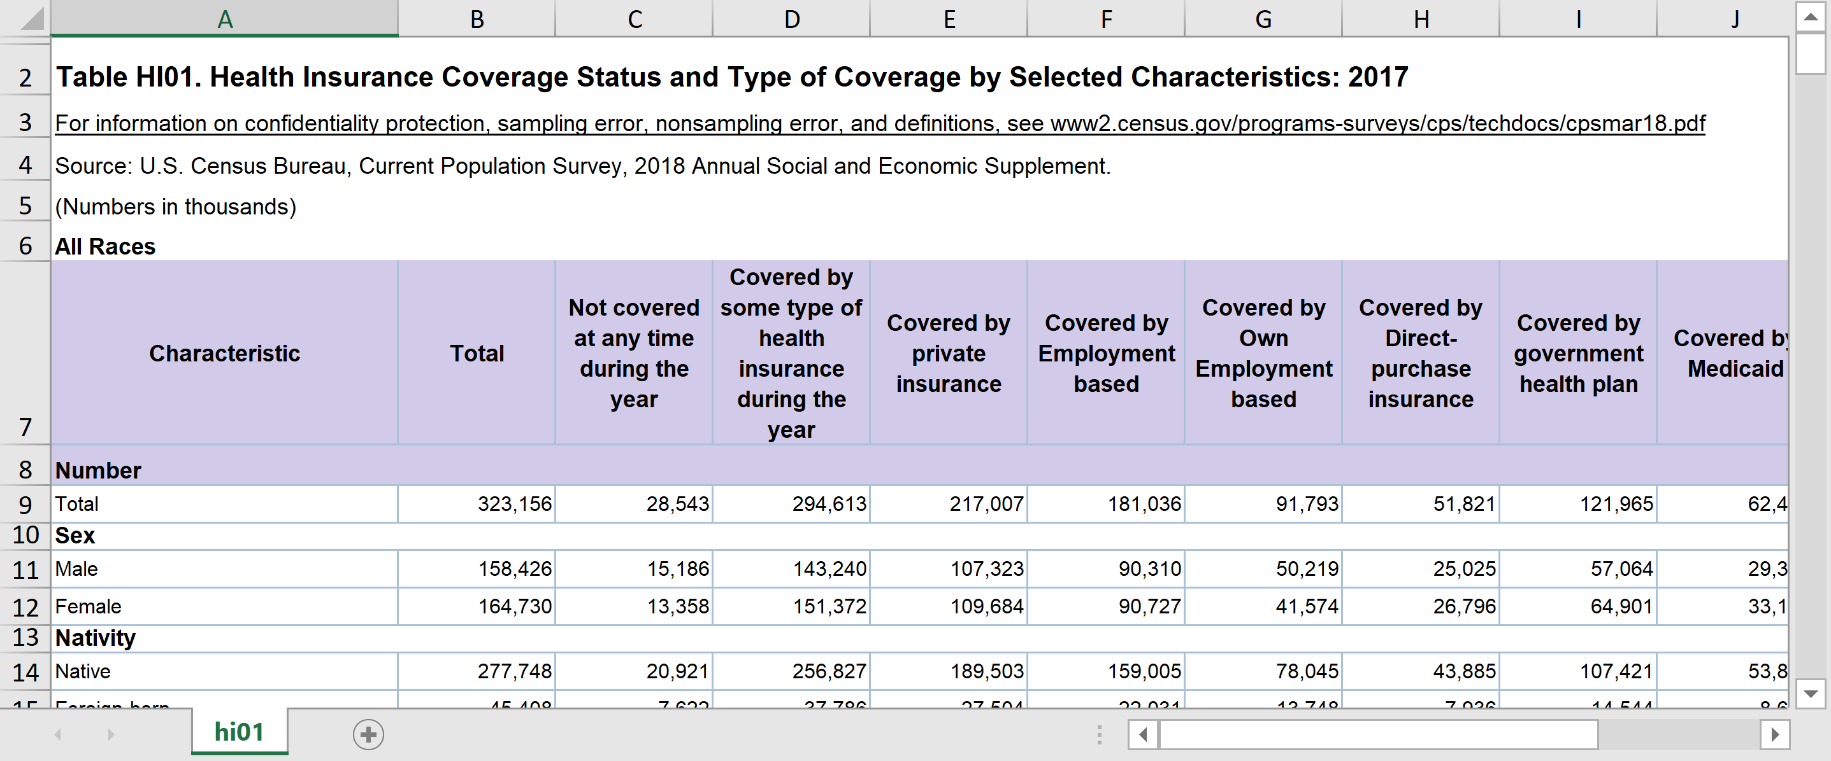
Table HI01 – Health Insurance Coverage by Selected Characteristics
Pre-tabulated CPS tables provide data for health insurance by sex, but what if we also want to look at this crossed by disability status?

Slide 10
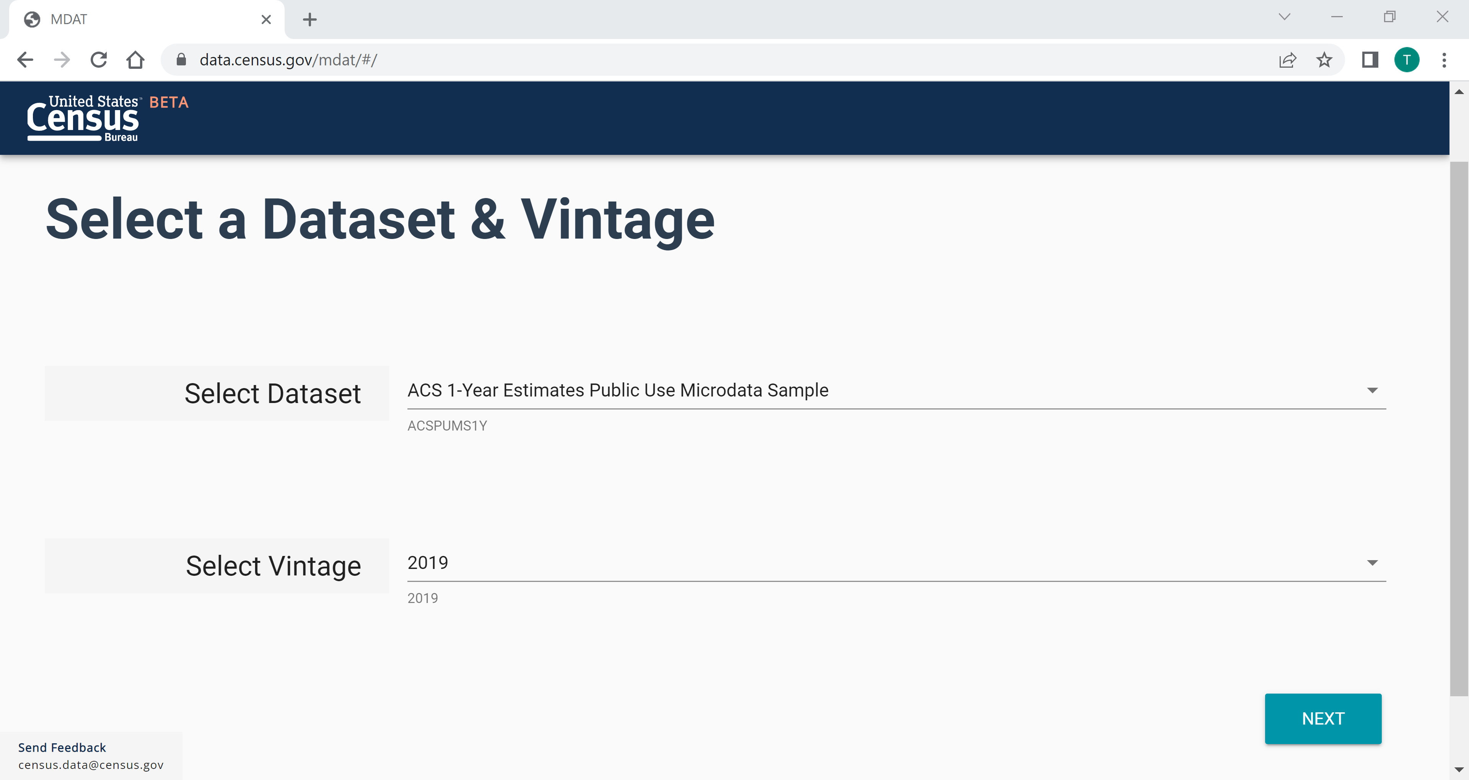
    Demo 1
Visit Microdata Access at data.census.gov/mdat
data.census.gov/mdat

Slide 11
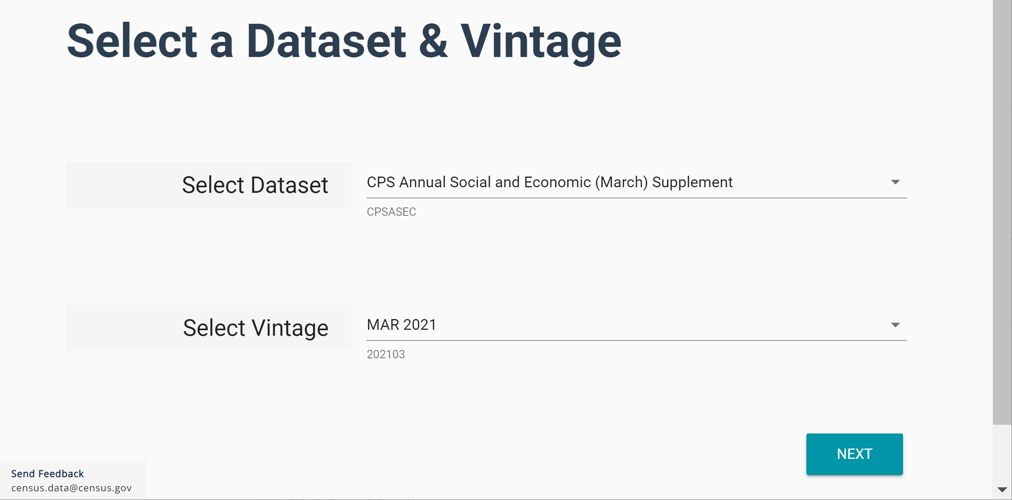
    Demo 1
Choose Dataset and Vintage:
  Dataset – CPS Annual Social and Economic (March) Supplement
  Vintage – MAR 2021
  Click Next in the lower right

Slide 12
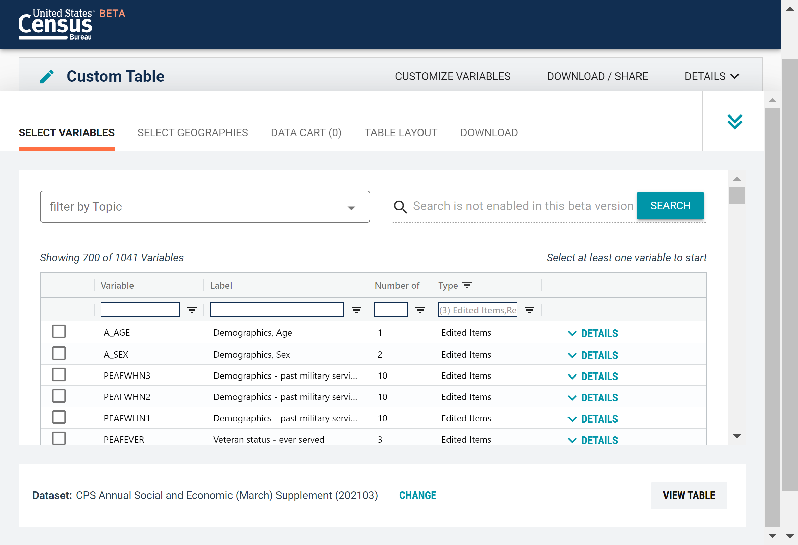
    Demo 1
Search for Variables: Use the search box below “Variable” or “Label” to find your variables of interest

Slide 13
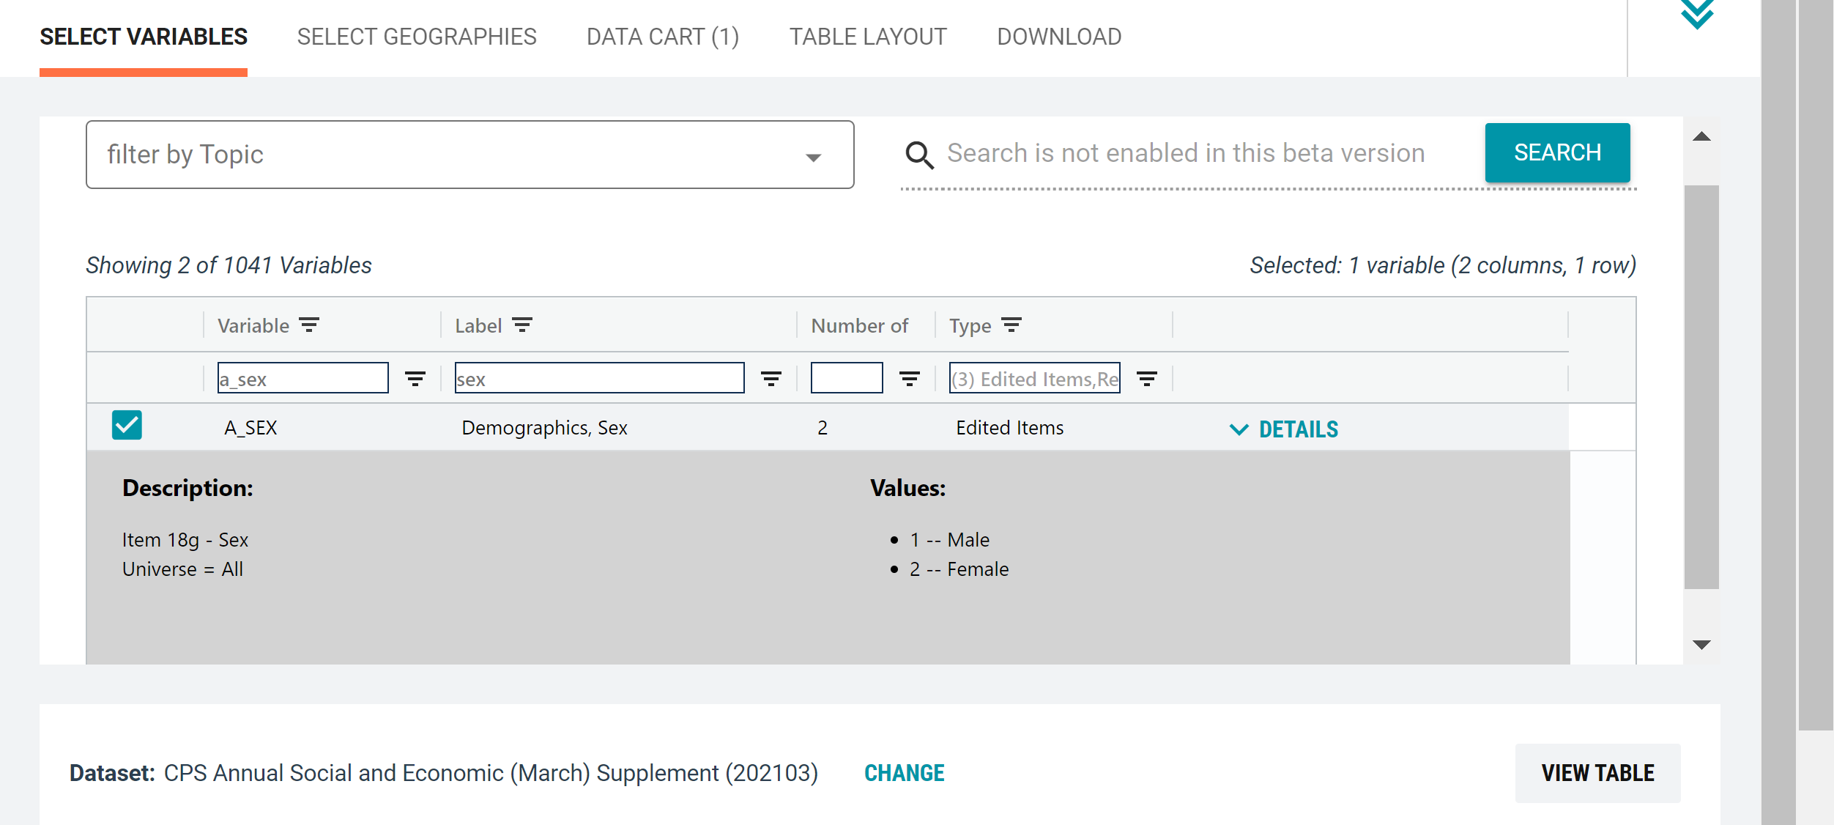
    Demo 1
Select variable for Sex:
  Type “A_SEX” in the Variable search box or type “Sex” in the label search box
  Click the Details link to view possible values for this variable
  Check the box to the left of A_SEX to add the variable to data cart

Slide 14
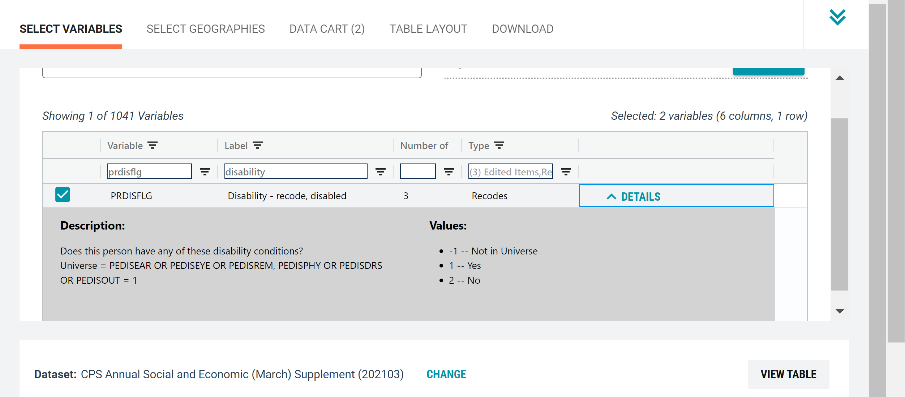
    Demo 1
Select variable for Disability:
  Type “PRDISFLG” in the Variable search box or type “Disability” in the label search box
  Click the Details link to view possible values for this variable
  Check the box to the left of PRDISFLG to add the variable to data cart

Slide 15
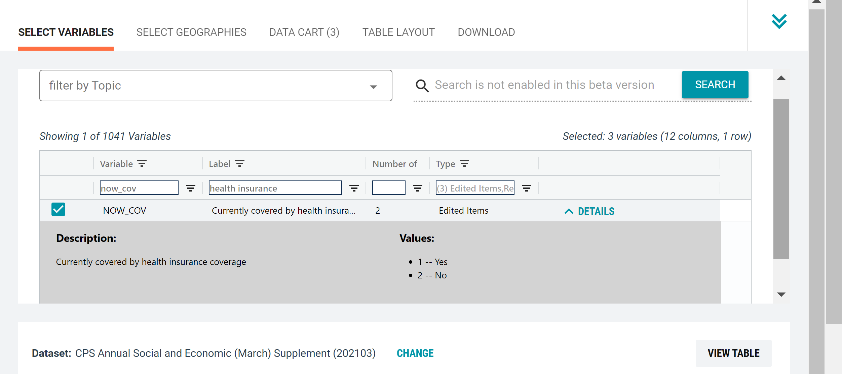
    Demo 1
Select variable for Health Insurance:
  Type “NOW_COV” in the Variable search box or type “health insurance” in the label search box
  Check the box to the left of NOW_COV to add the variable to data cart

Slide 16
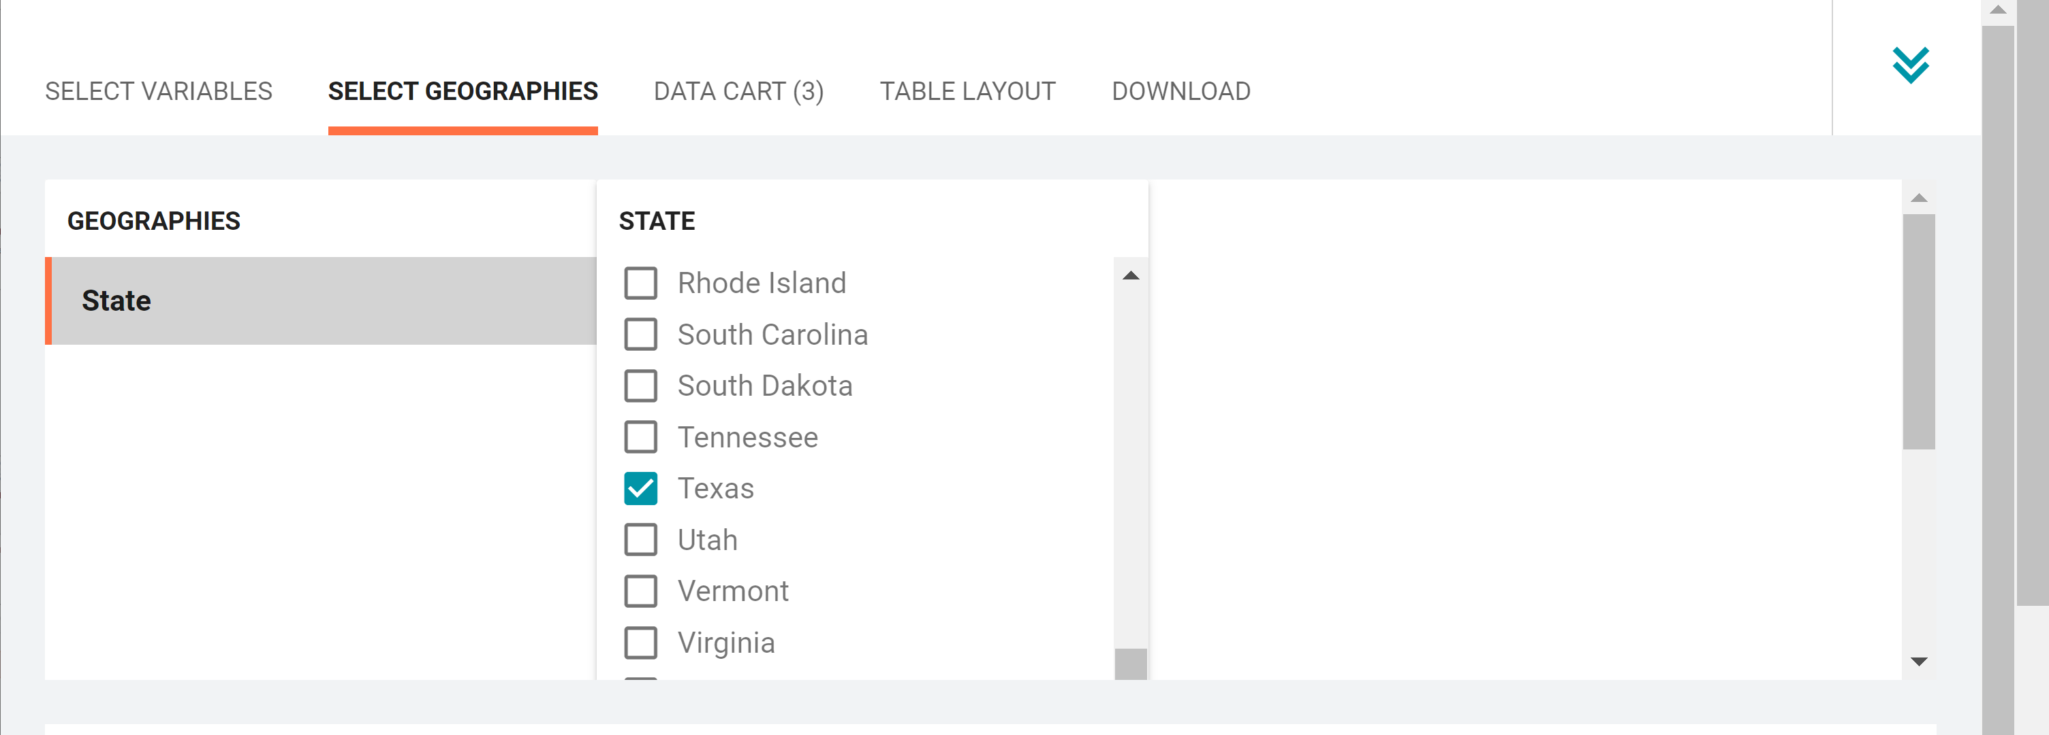
    Demo 1
Select geography:
  Click the SELECT GEOGRAPHIES tab
  Click State and check the box for Texas

Slide 17
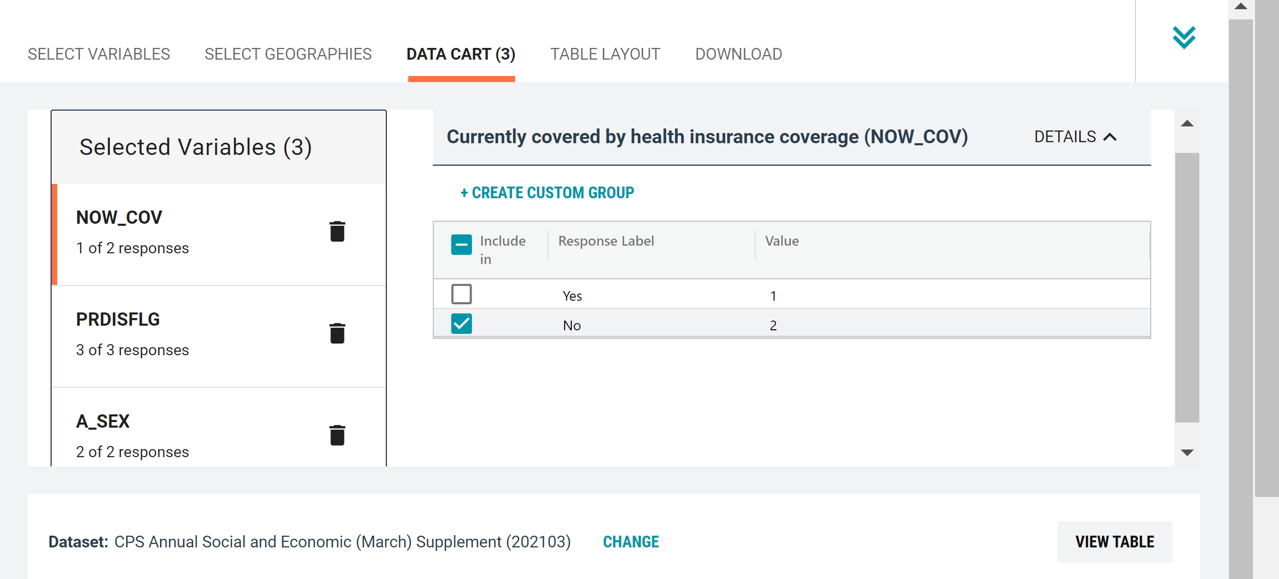
    Demo 1
Limit your universe:
  Click the DATA CART tab
  Click the NOW_COV variable on the left
  Uncheck the box for Yes to exclude people with health insurance coverage

Slide 18
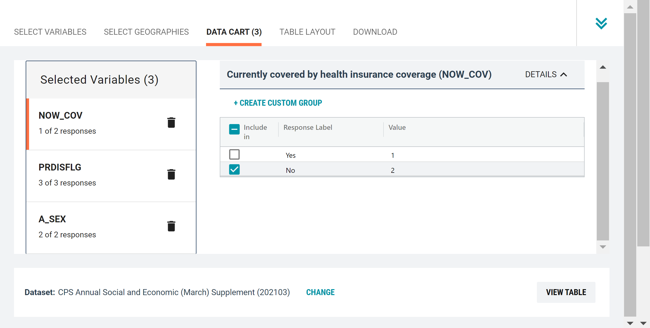
    Demo 1
Confirm variable selections
  Confirm variable selections and click the Table Layout tab

Slide 19
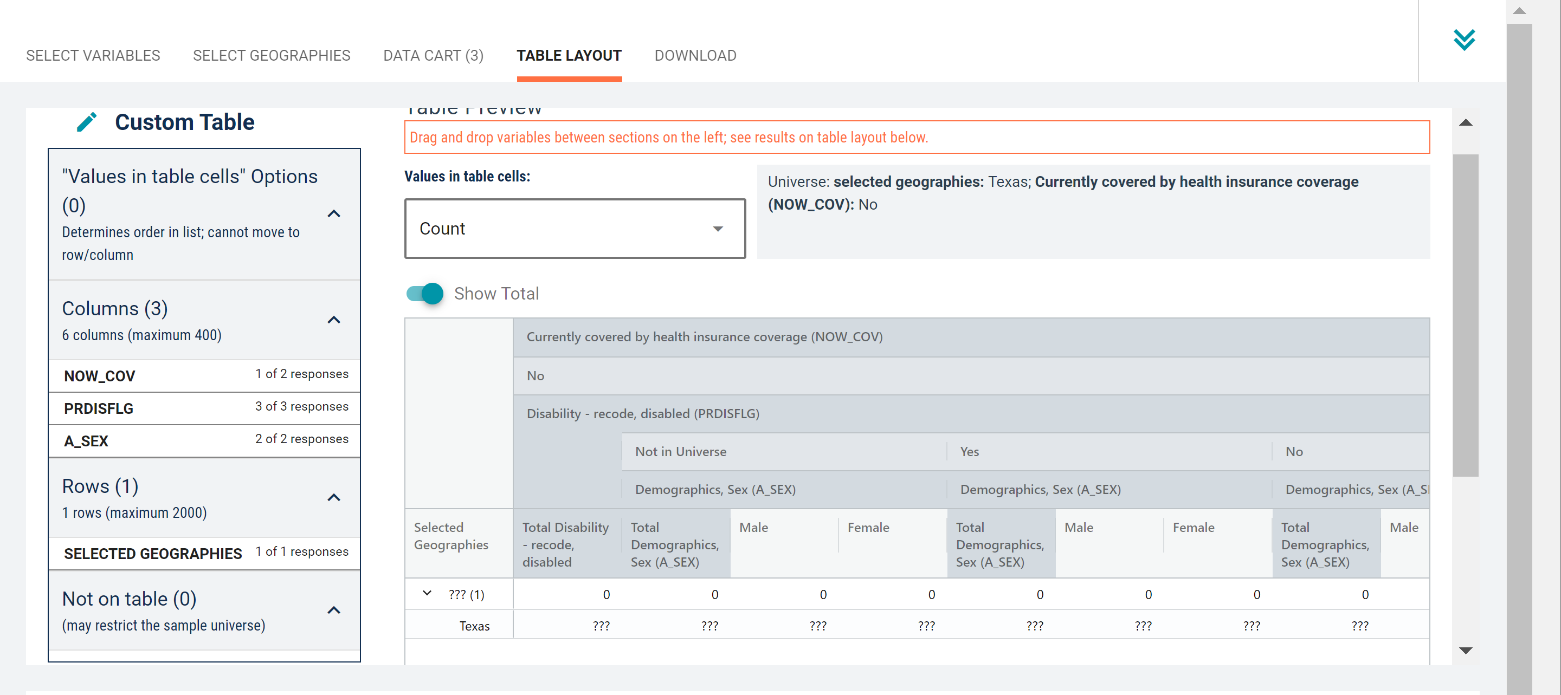
    Demo 1
View variable placement in the default table layout:
  Columns/Rows – Variables will be shown in the table. By default, the table is providing data for sex and disability status for the population without health insurance in the columns, with the geography (Texas) in the rows

Slide 20
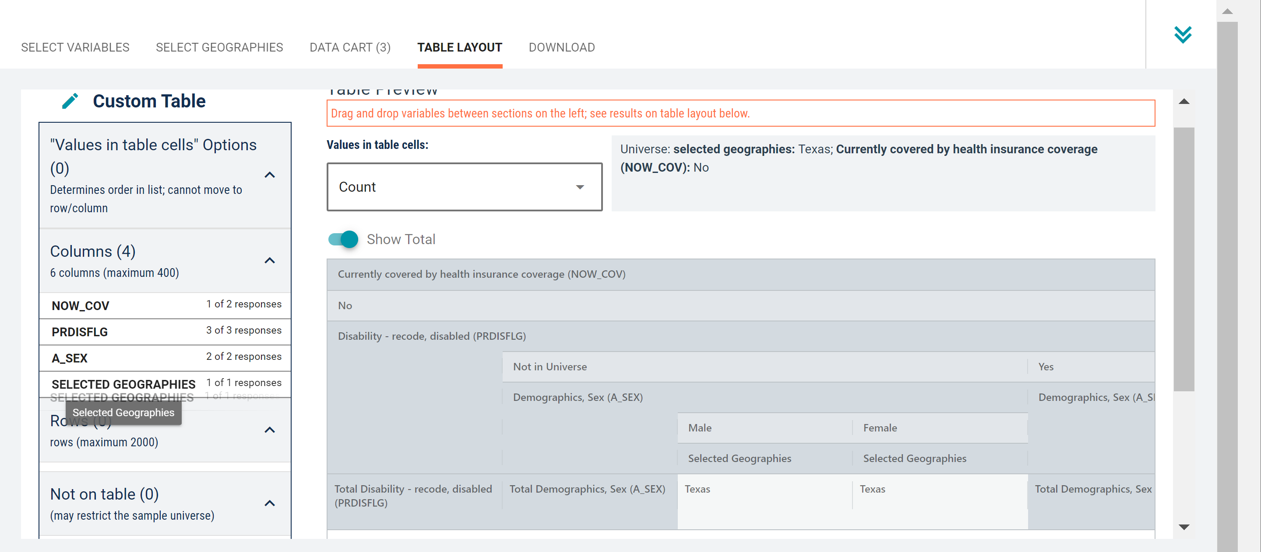
    Demo 1
Edit Table Layout:
  Move Selected Geography to Columns:
    Click, hold and drag Selected Geographies on the left side of the page to Columns. This will move the geography to appear in the columns instead of the rows.

Slide 21
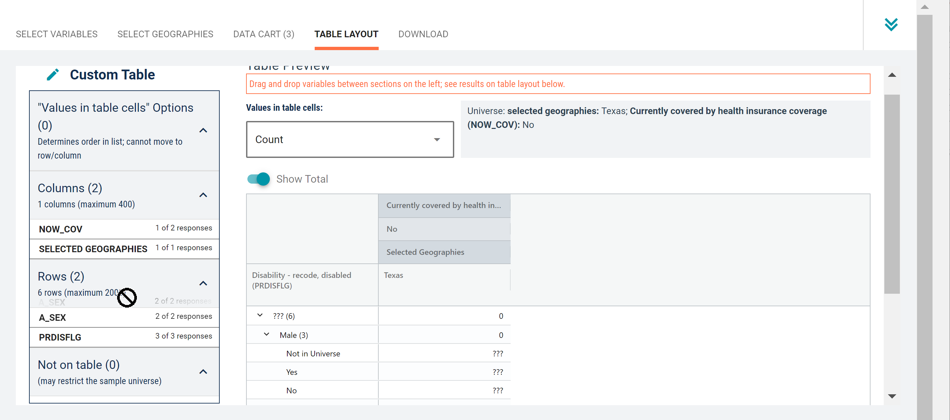
    Demo 1
Edit Table Layout:
  Move Sex and Disability Variables to Rows:
    Click, hold and drag A_SEX and PRDISFLG on the left side of the page down to Rows. This will move these variables to appear in the rows instead of the columns.

Slide 22
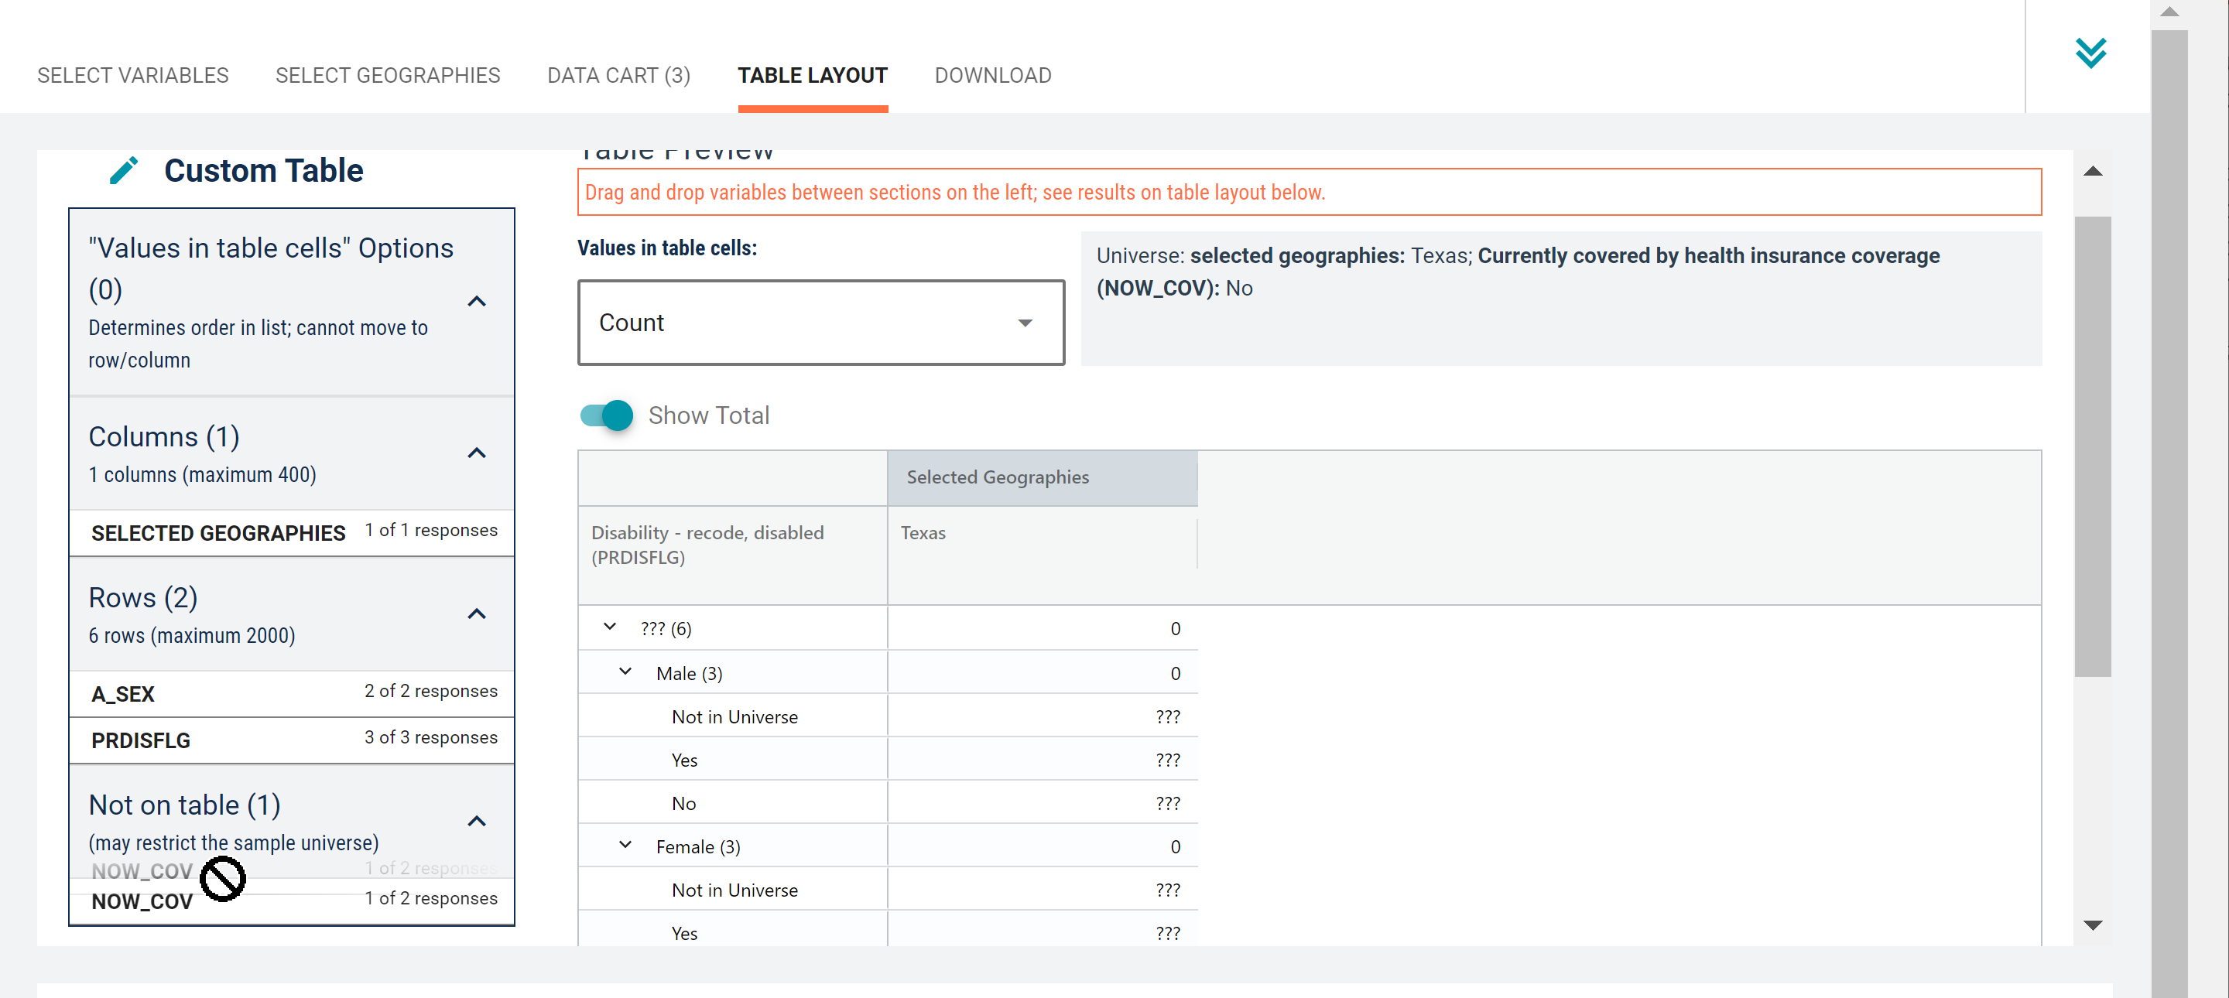
    Demo 1
Edit Table Layout:
  Move Health Insurance to Not on table:
    Click, hold and drag NOW_COV on the left side of the page down to Not on table. This will restrict the universe to only include data for the population without health insurance without showing a repeating label for it in the table.

Slide 23
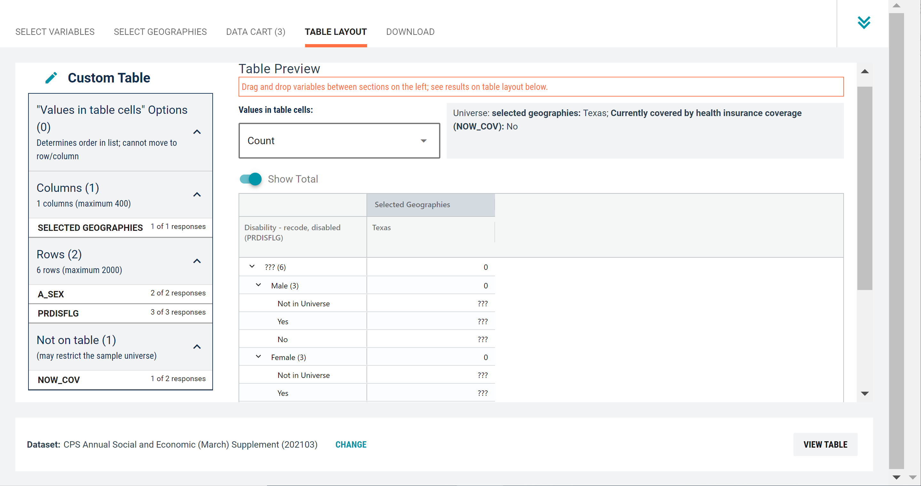
    Demo 1
Confirm Table Layout:
  Confirm table layout and click View Table in the lower right

Slide 24
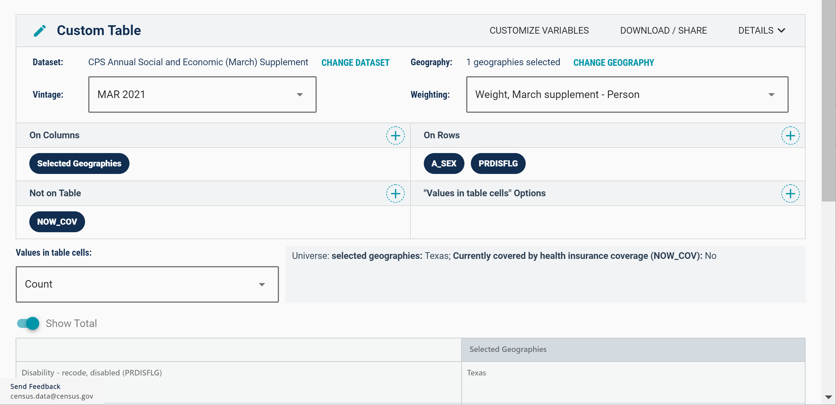
    Demo 1
View Table Information:
  View dataset, default weight, and universe details

Slide 25
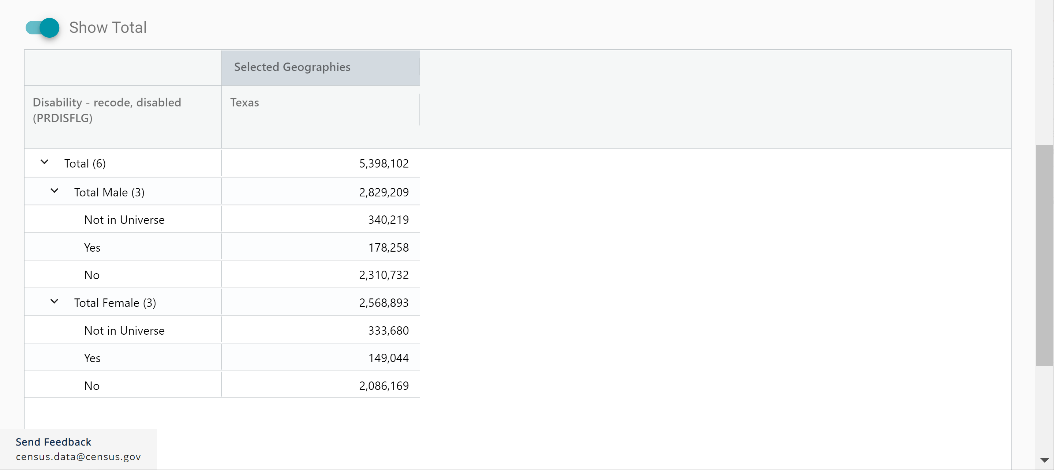
    Demo 1
View Table Data:
  View data for disability status by sex for the population without health insurance.

Slide 26
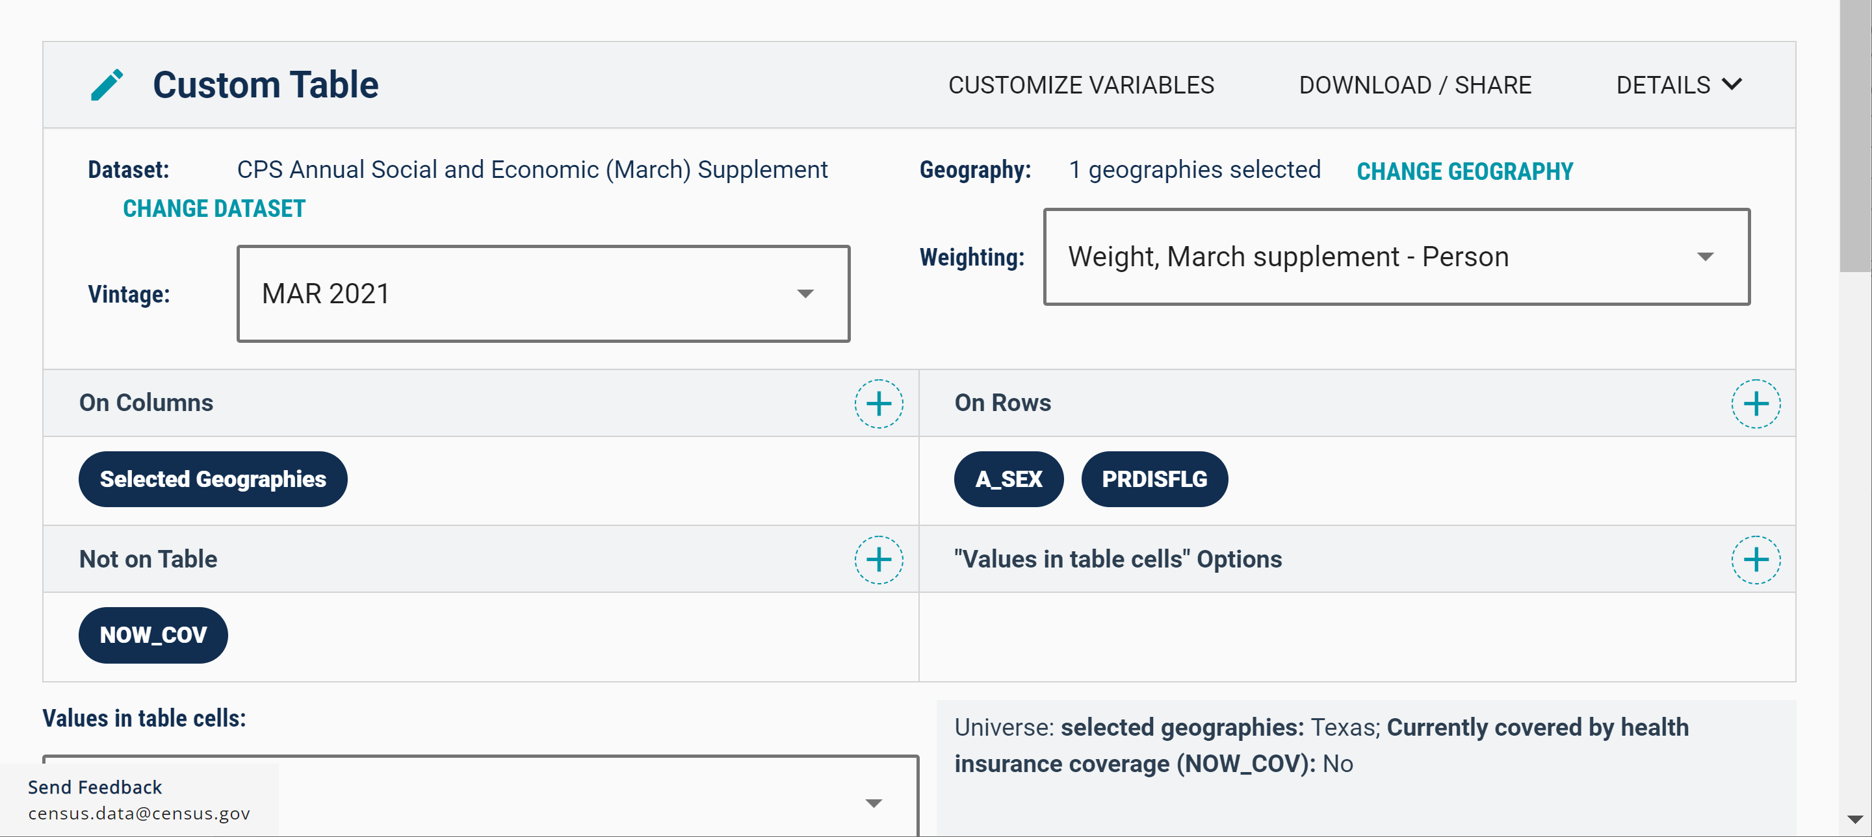
    Demo 1
Download:
  Click Download/Share at the top of the table

Slide 27
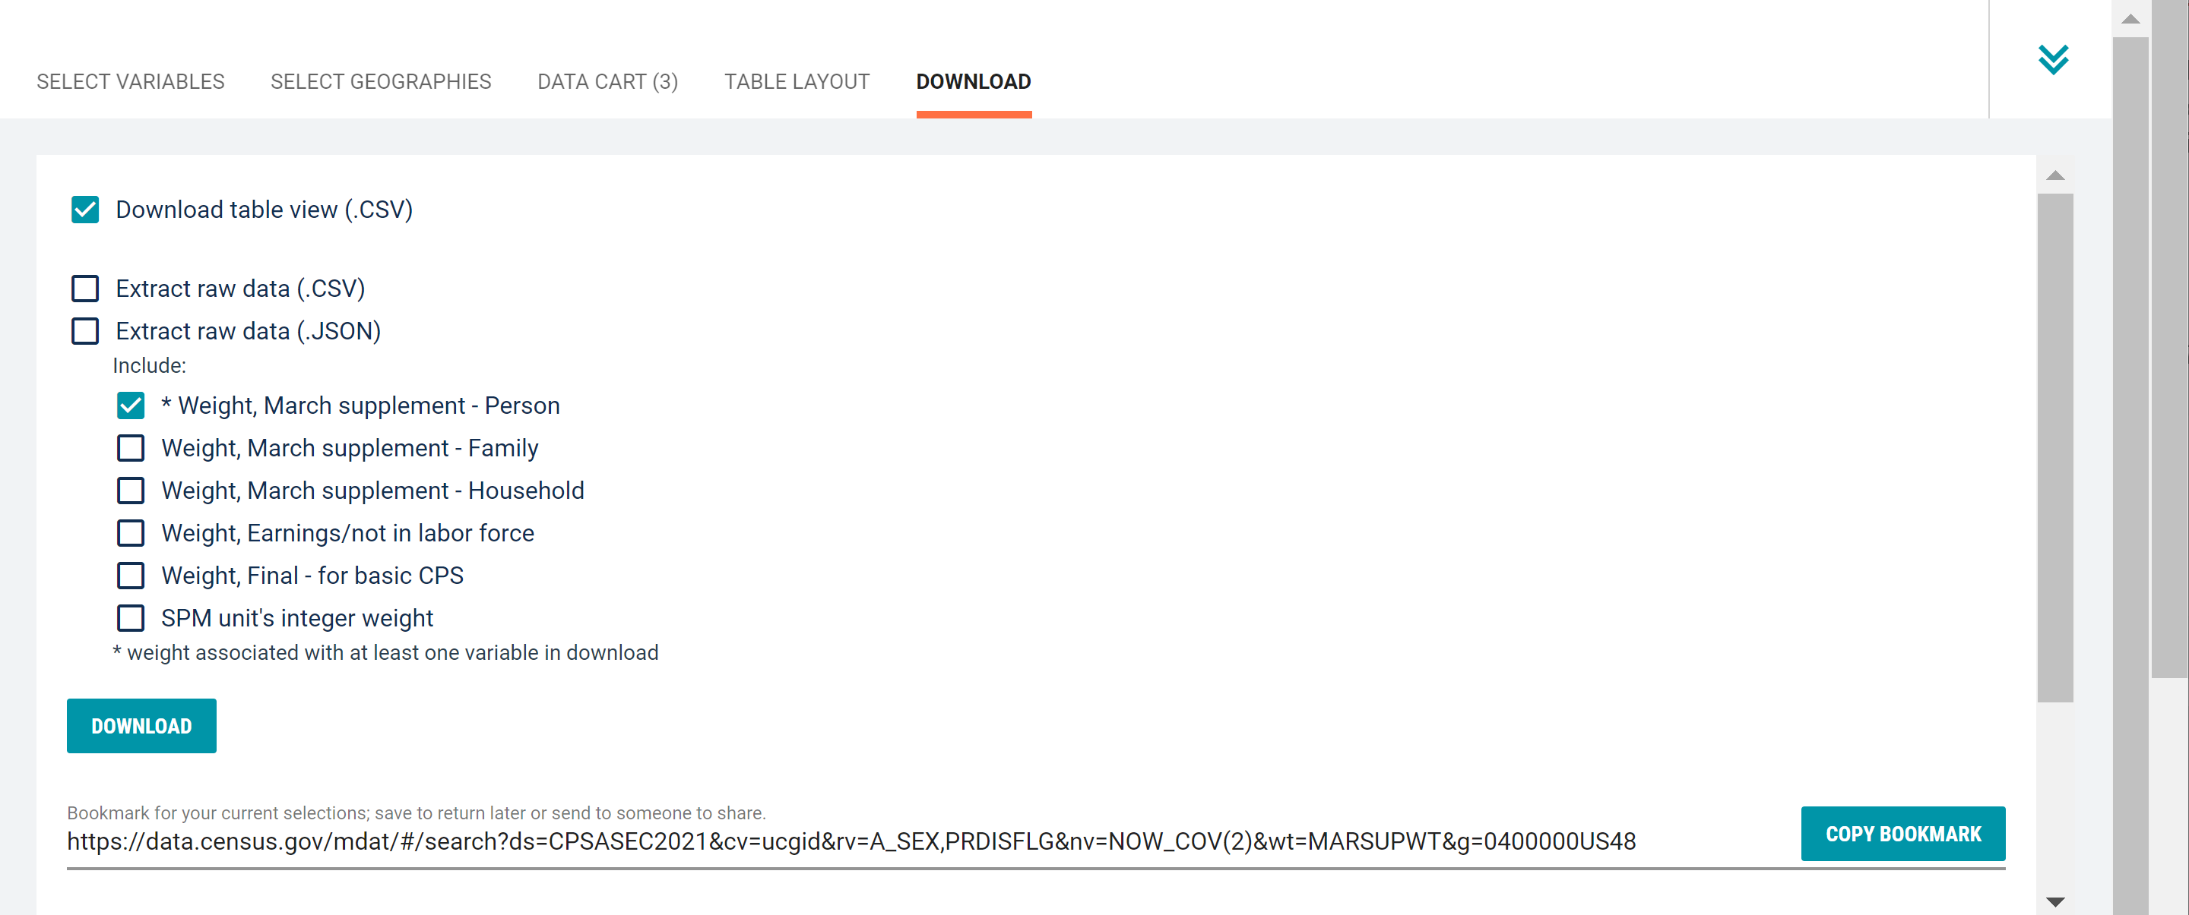
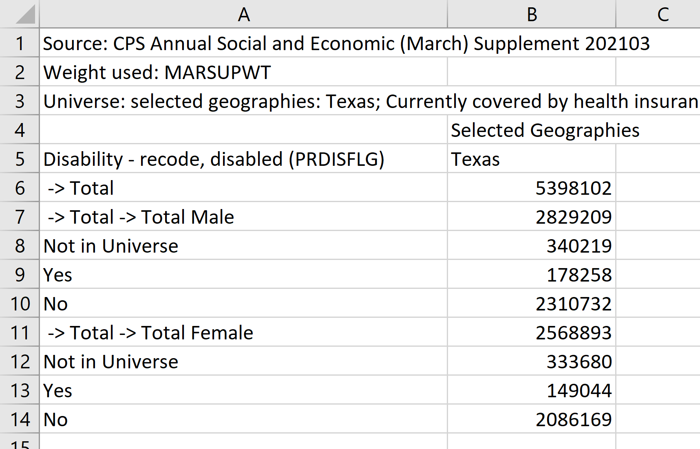
    Demo 1
Download:
  Select Download table view (.CSV), then click DOWNLOAD
  Click on export.csv to view your downloaded table

Slide 28
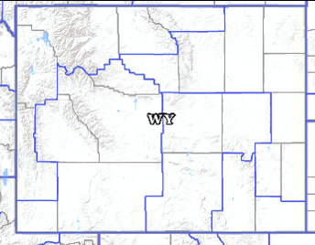
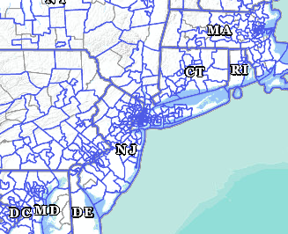
Public Use Microdata Areas (PUMAs)
Defined area with 100,000+ population:
  PUMAs (or collections of PUMAS) can be used to identify most cities of 100,000+ and many metro areas, but not all
Identified by five-digit code (unique within each state)
Nest within states and cover the entire nation
Defined after each decennial census
Census tracts and counties are the building blocks

Slide 29
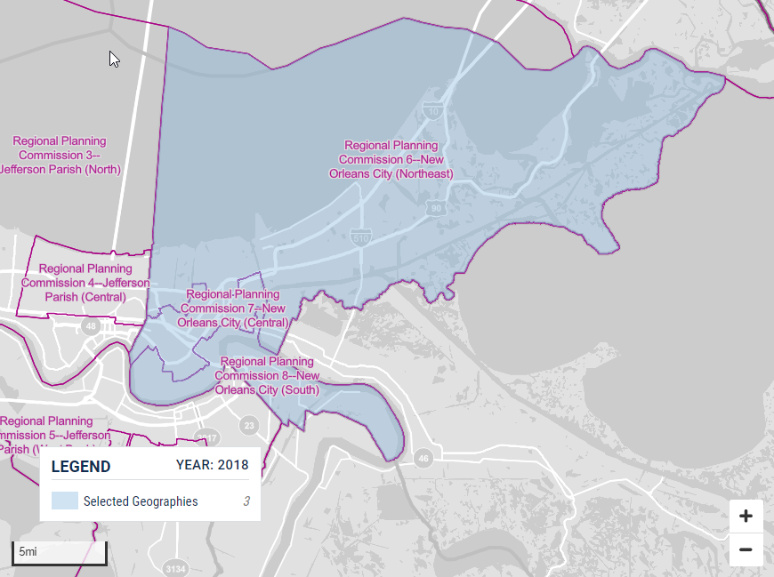
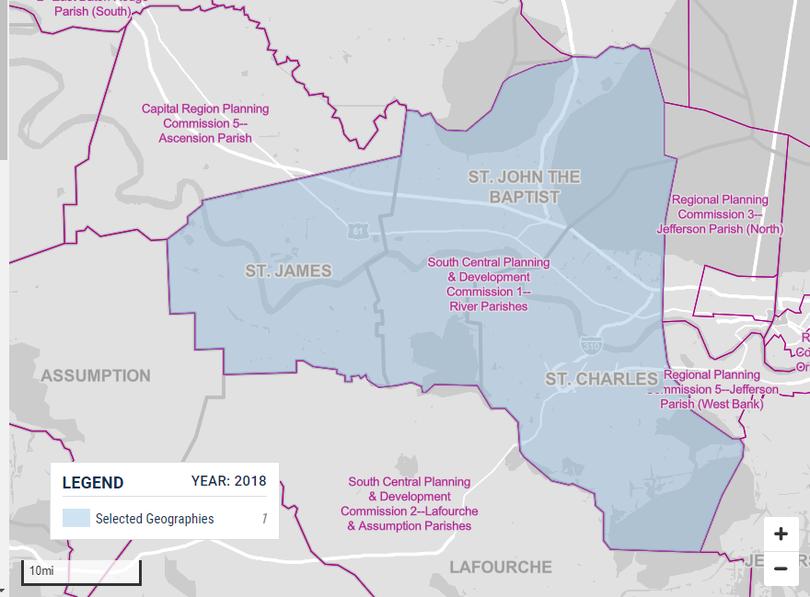
Visualizing PUMAs through data.census.gov
Three PUMAs cover the city of New Orleans:
PUMA 02400
PUMA 02401
PUMA 02402
Louisiana PUMA 01900 covers 3 county equivalents:
St James Parish
St John the Baptist Parish
St Charles Parish
29

Slide 30
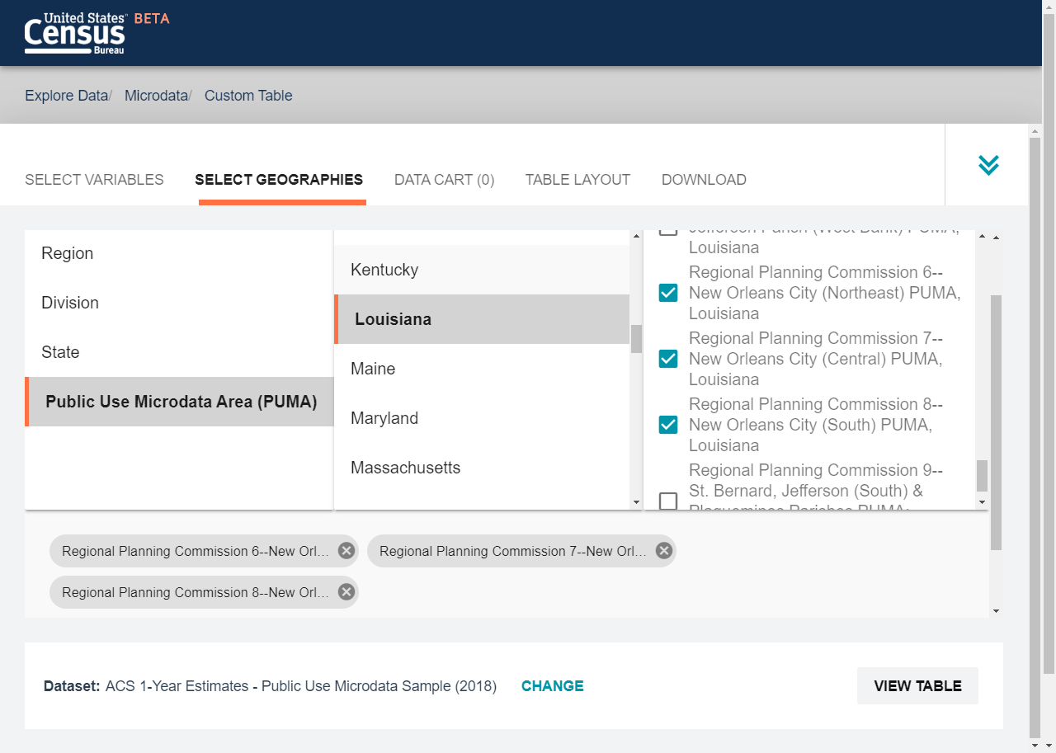
Selecting PUMAs in Microdata Access
If you want lower level geographic areas it’s easy to select your PUMAs on Microdata Access.
30

Slide 31
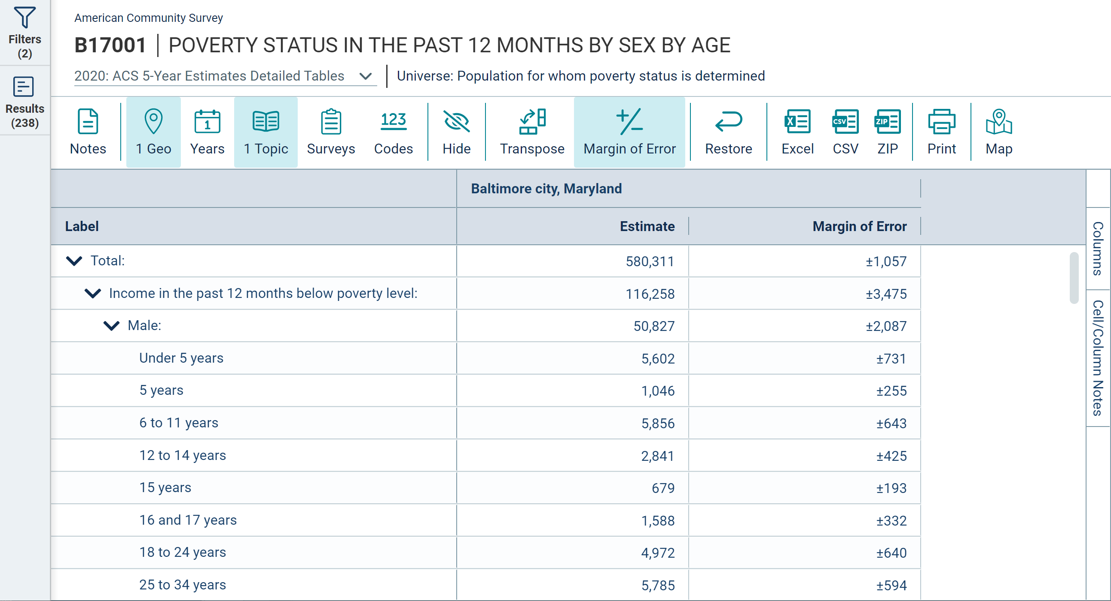
Table B17001 – Poverty Status by Sex by Age
Annually released pre-tabulated ACS tables provide poverty data for age ranges, but what if we want data by single year of age?

Slide 32
Microdata Access Demo
Select Variables and Geographies, Limit Universe, Define Table Layout, and Save Results
    Sex by Disability Status for the Population without Health Insurance in Texas from the CPS ASEC
Recode Continuous Variables and Select PUMAs
    Poverty Status by Single Year of Age in Baltimore city PUMAs based on the ACS

Slide 33
    Demo 1
Visit Microdata Access at data.census.gov/mdat
data.census.gov/mdat

Slide 34
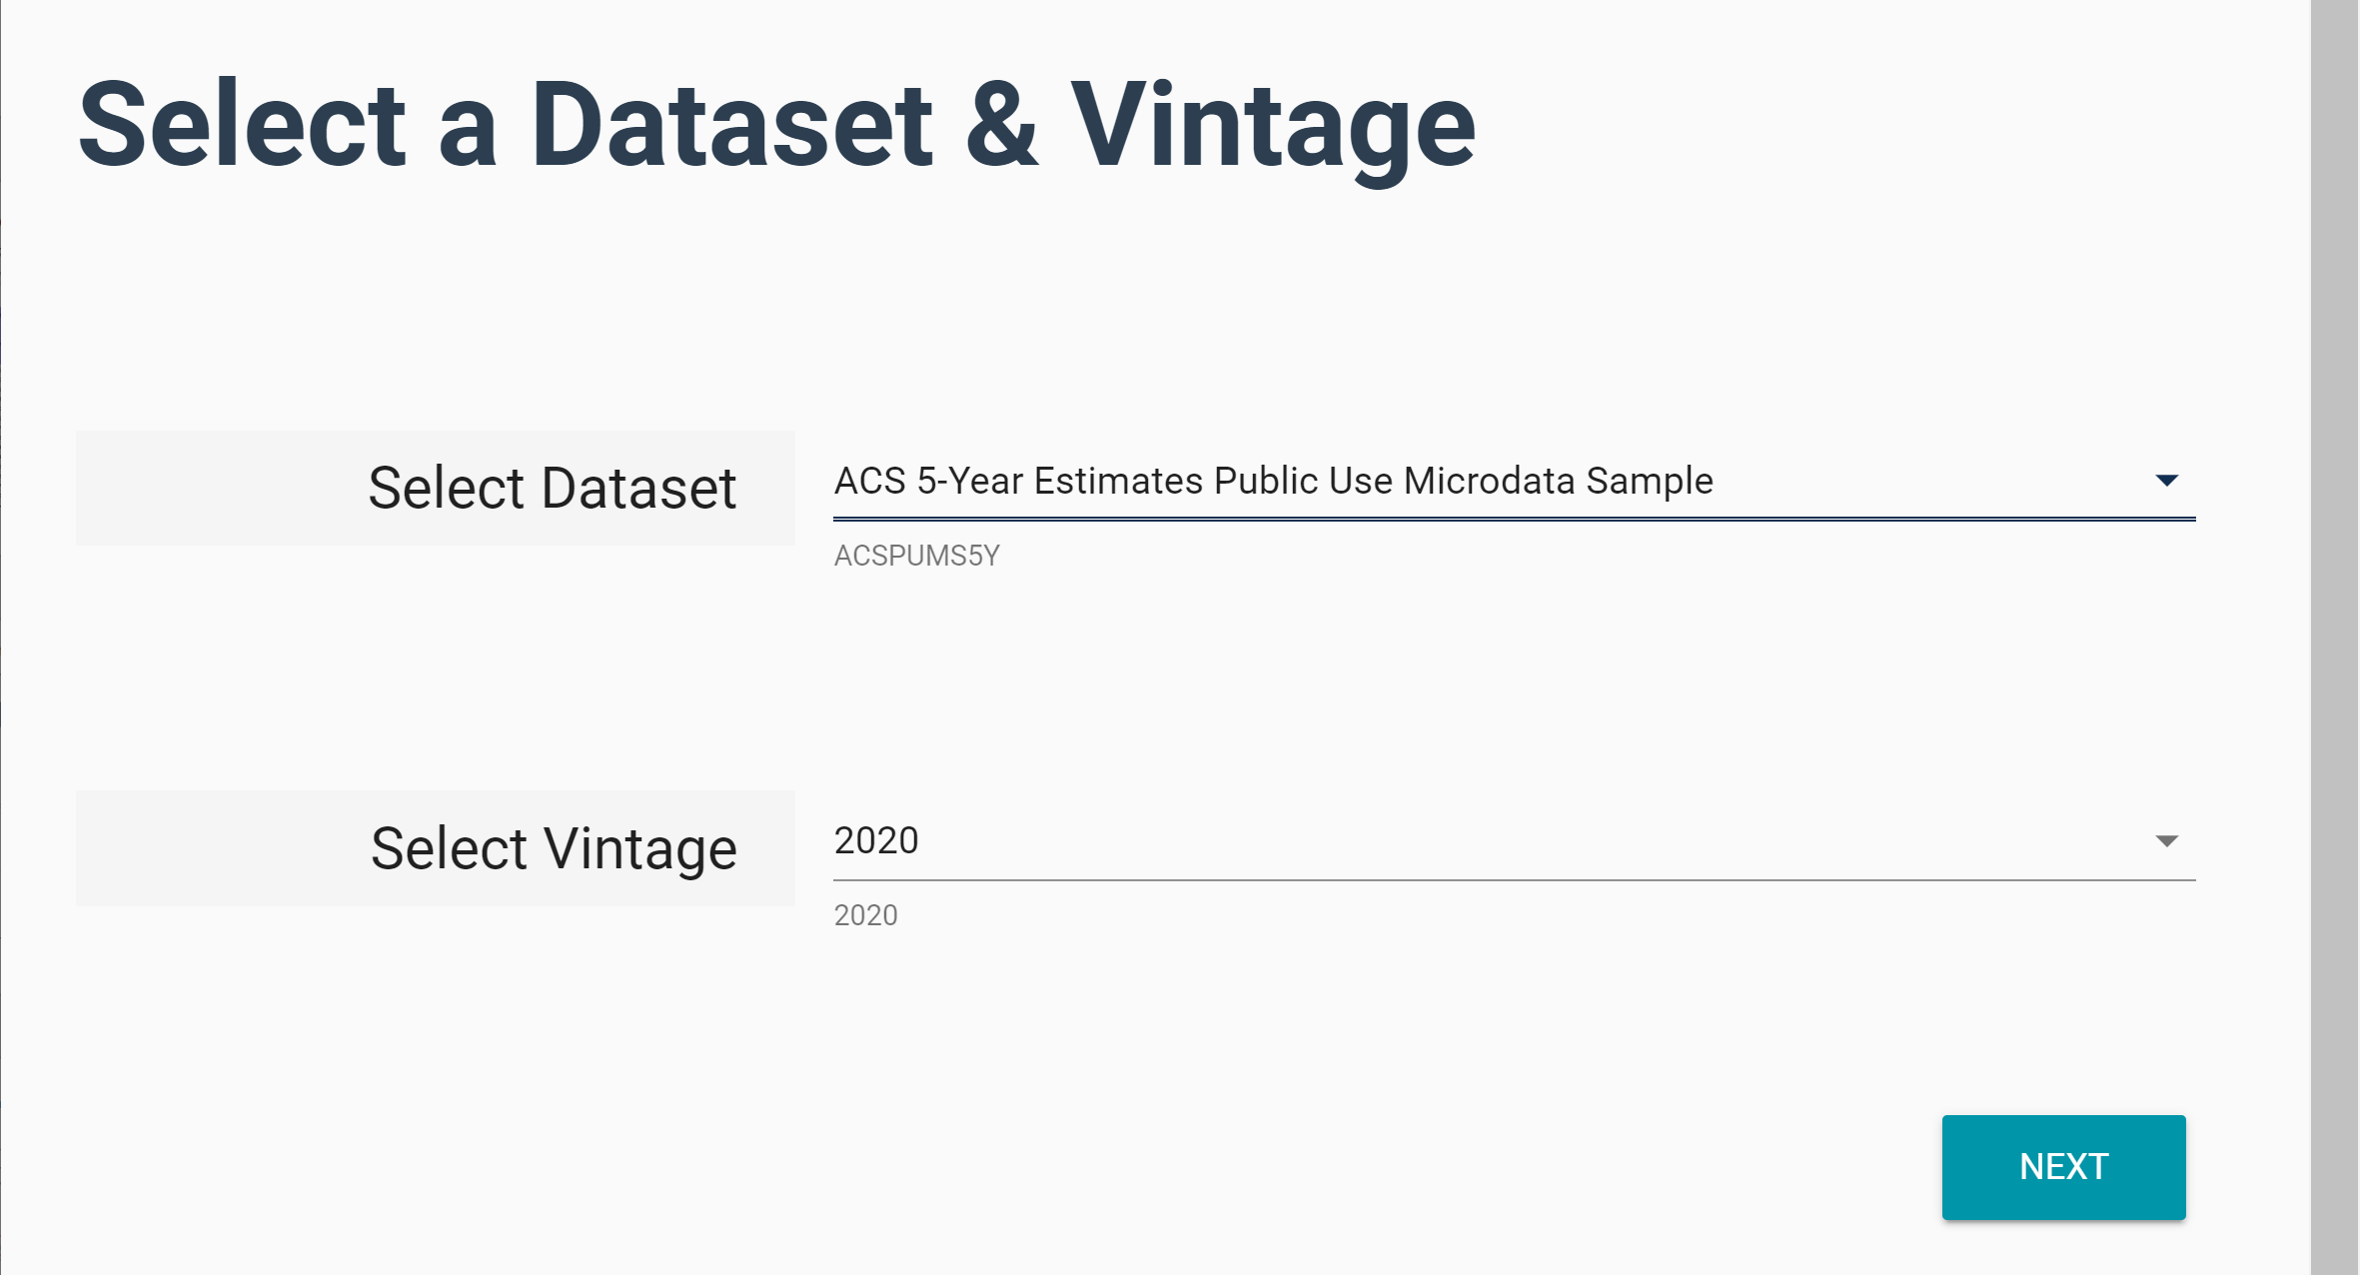
    Demo 1
Choose Dataset and Vintage:
  Dataset – ACS 5-Year Estimates Public Use Microdata Sample
  Vintage – 2020
  Click Next in the lower right

Slide 35
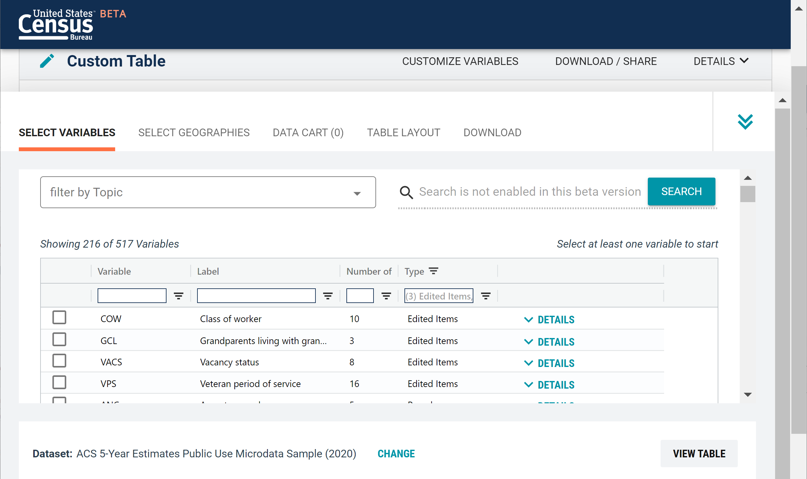
    Demo 1
Search for Variables: Use the search box below “Variable” or “Label” to find your variables of interest

Slide 36
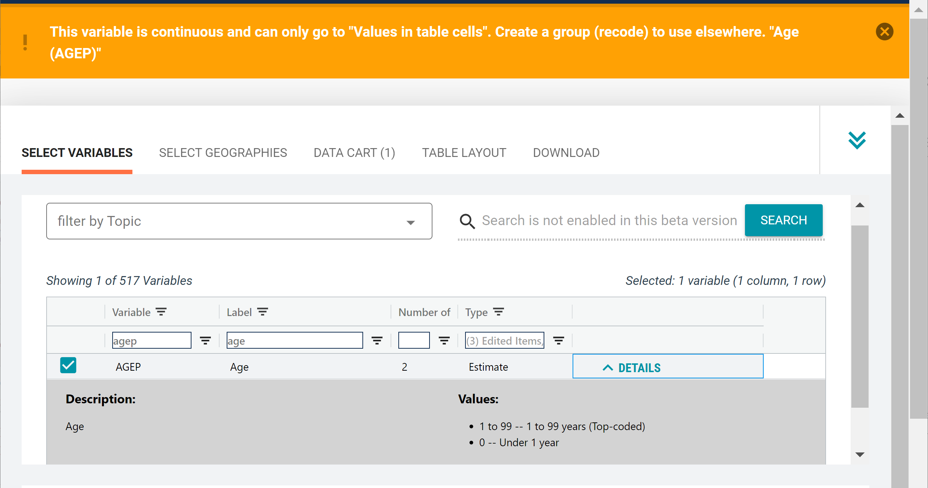
    Demo 2
Select variable for Age:
  Type “AGEP” in the Variable search box or type “Age” in the label search box
  Check the box to the left of AGEP to add the variable to your data cart
  Notice the message at the top of the screen saying you will need to create your own categories (or recodes) for this variable if you want it shown in the table (you will do this action in the Data Cart)
36

Slide 37
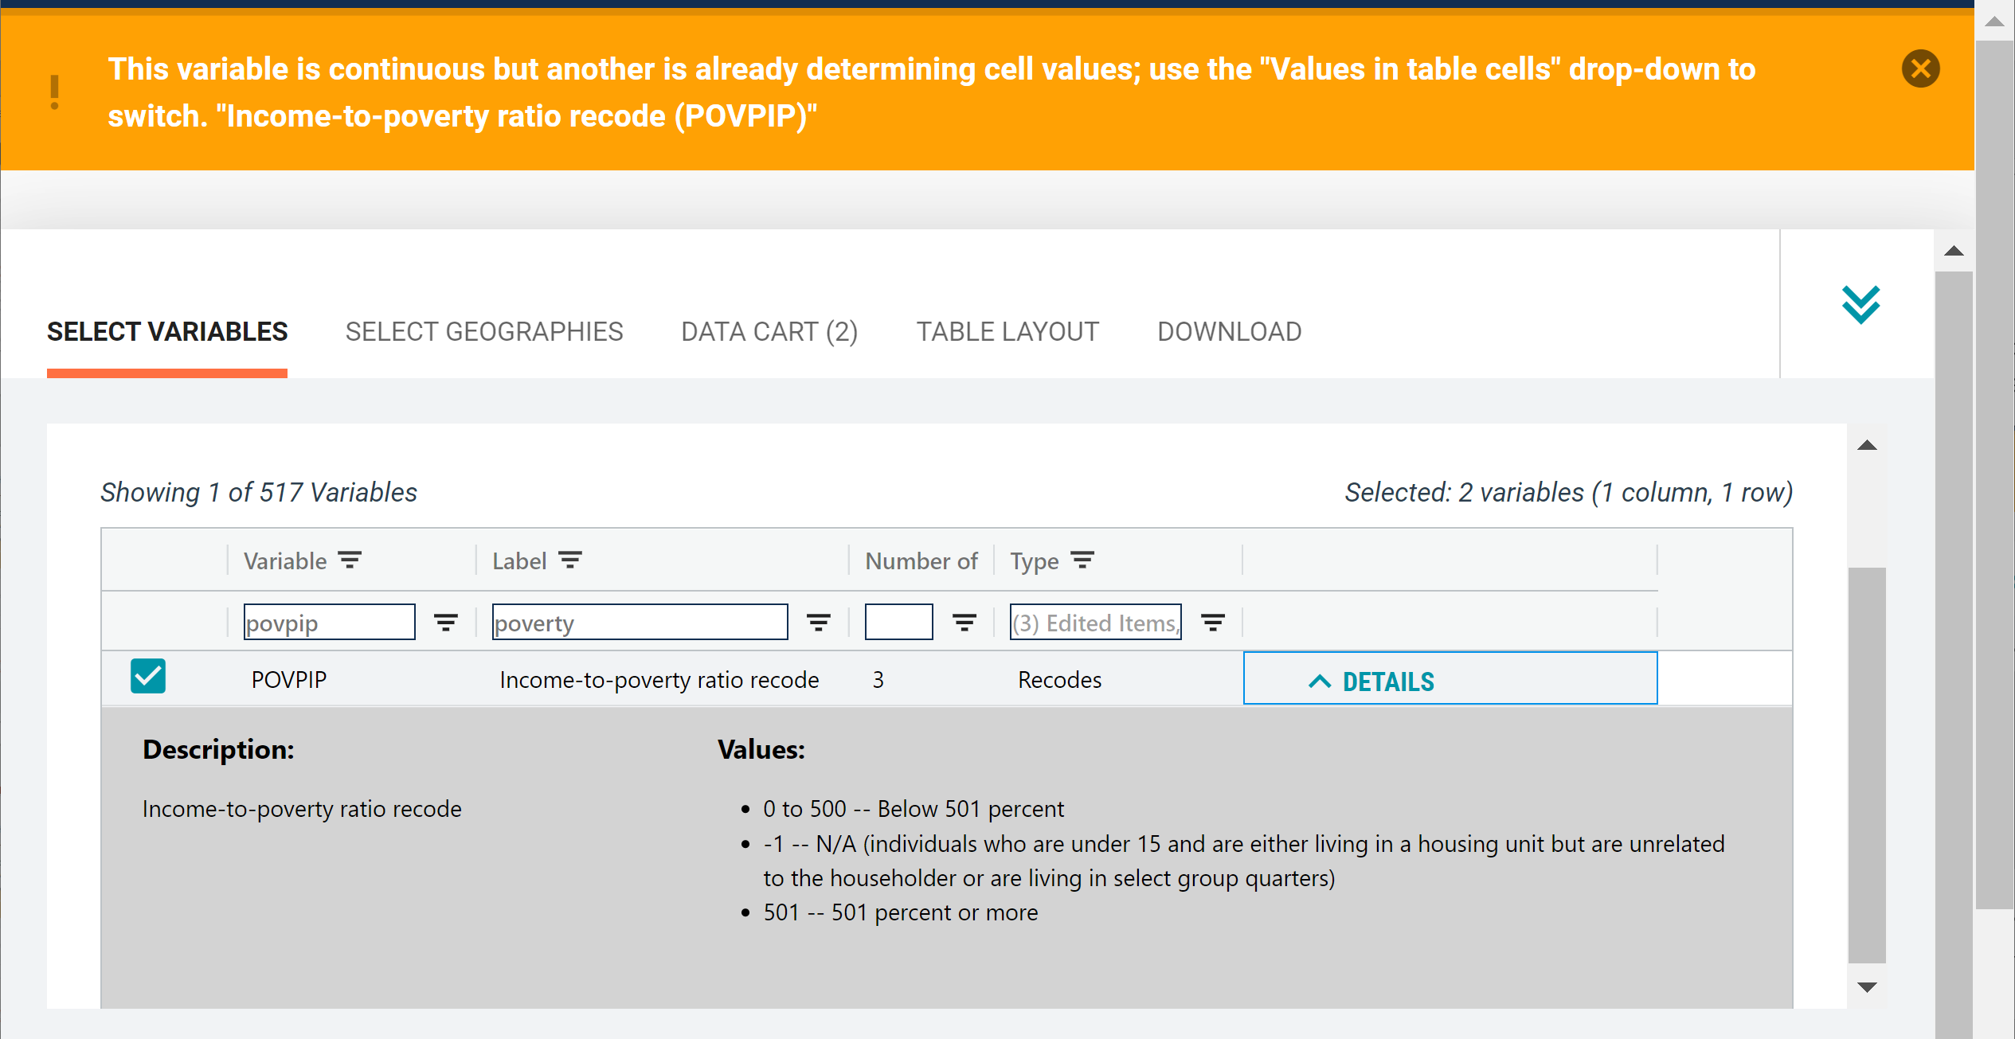
    Demo 2
Select variable for Poverty:
  Type “POVPIP” in the Variable search box or type “poverty” in the label search box
  Check the box to the left of POVPIP to add the variable to your data cart
  Notice the message at the top of the screen saying that this is a continuous variable
37

Slide 38
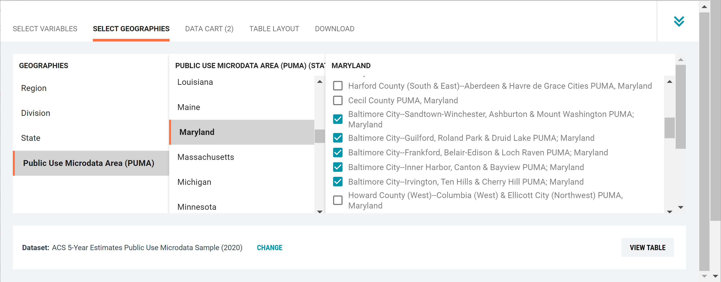
    Demo 3
Select geography:
  Click the SELECT GEOGRAPHIES tab
  Click Public Use Microdata Area (PUMA) and Maryland
  Check the boxes for the 5 Baltimore City PUMAs

Slide 39
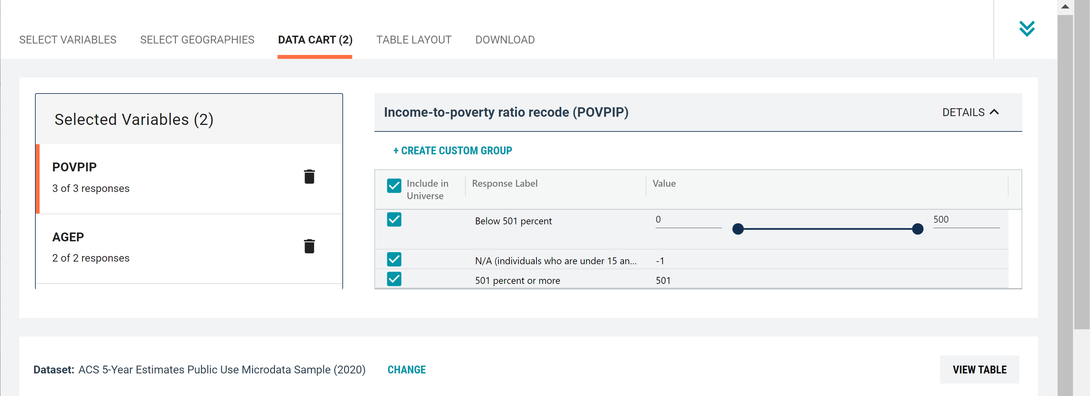
    Demo 2
Categorize (recode) your variable:
  Click the POVPIP variable on the left
  Click Create Custom Group to begin specifying your age categories (e.g. 0-39; 40 and over)
39

Slide 40
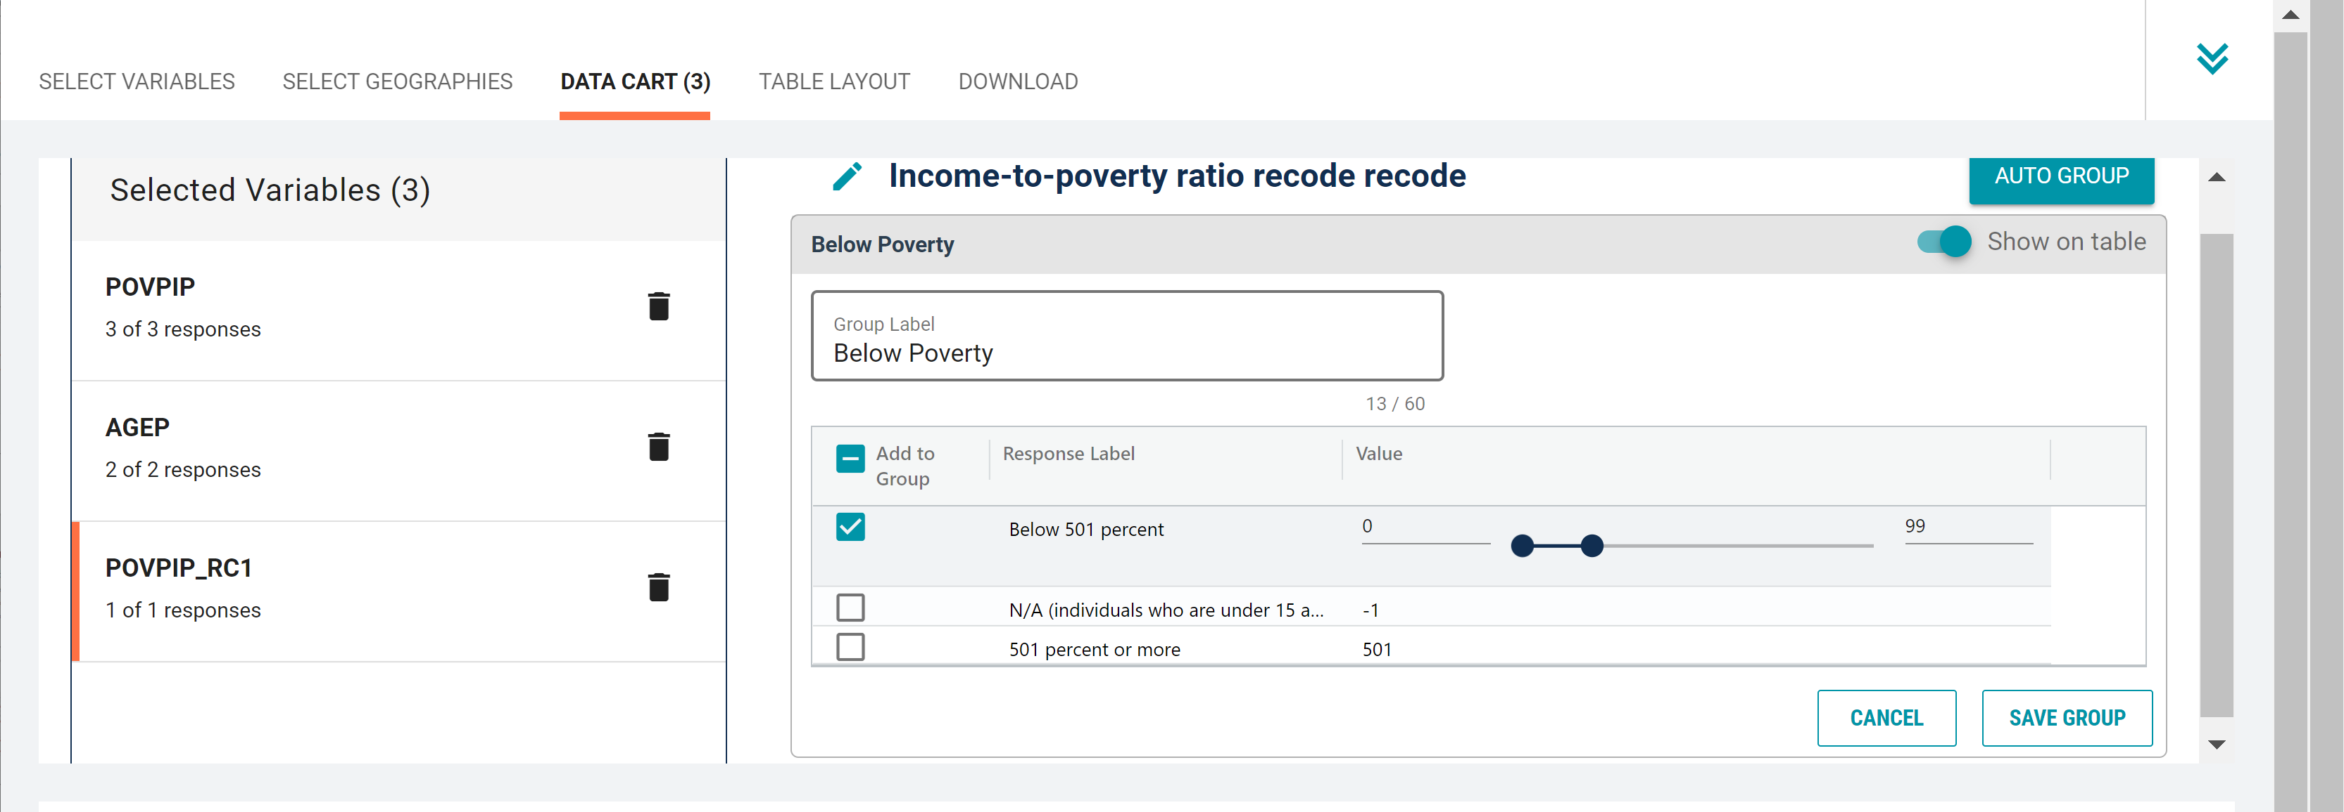
    Demo 2
Categorize (recode) your variable:
  Click into Group label and type a label for the first category you want to create (e.g. Below Poverty)
  Check the box next to the relevant response category for this code (Below 501 percent)
  Edit the end range of age from 500 to 99
  Click Save Group
40

Slide 41
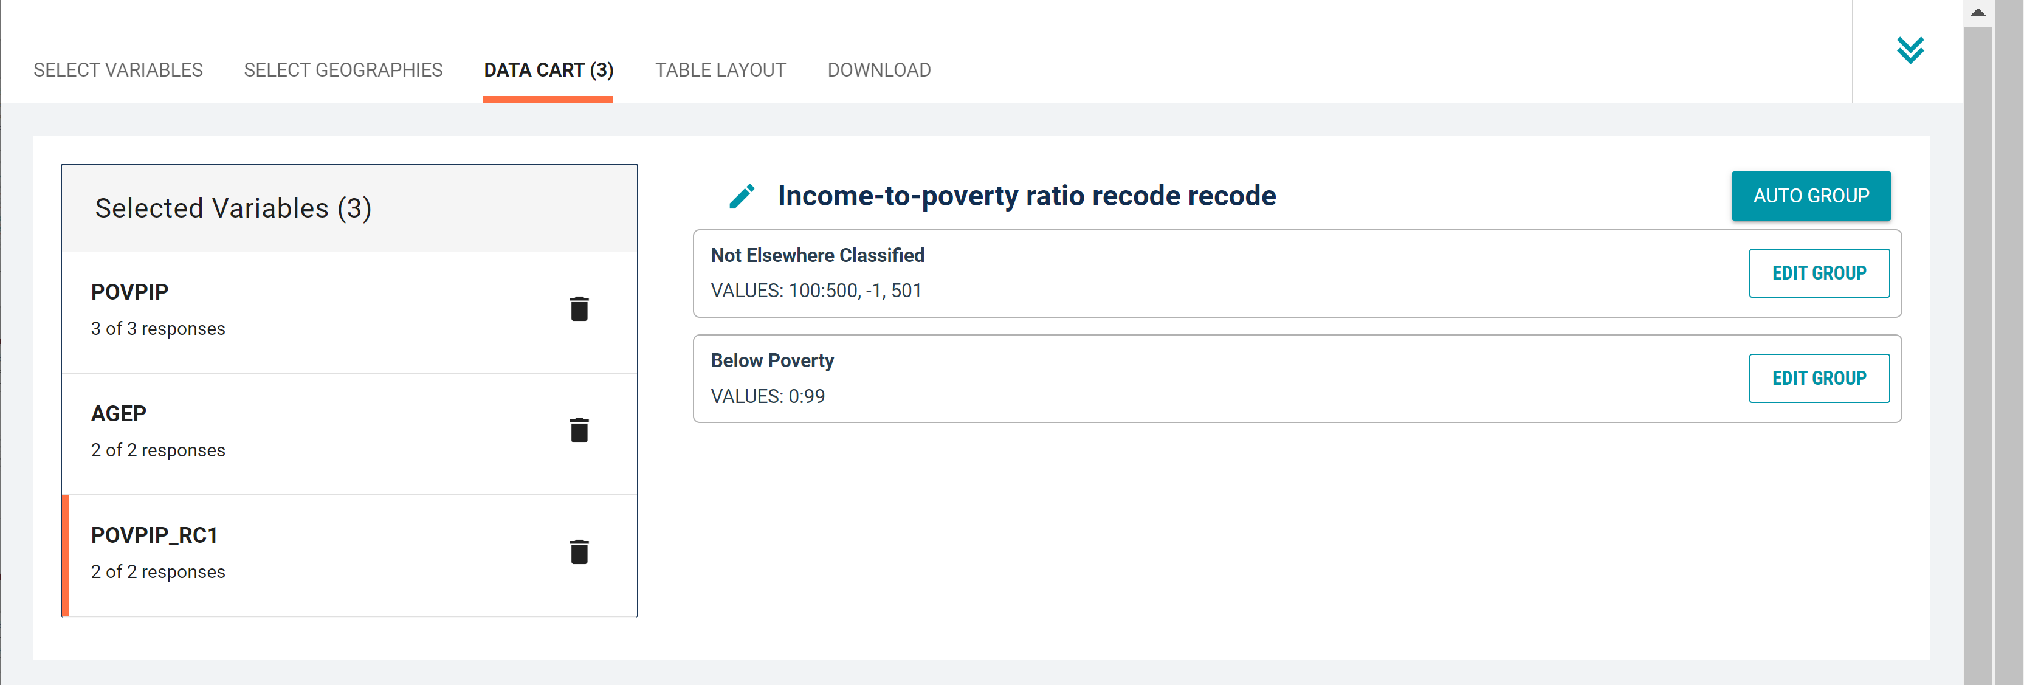
    Demo 2
Categorize (recode) your variable:
  Your first category Below Poverty appears just below “Not Elsewhere Classified”
  Click Edit Group for “Not Elsewhere Classified” to continue to create more categories
41

Slide 42
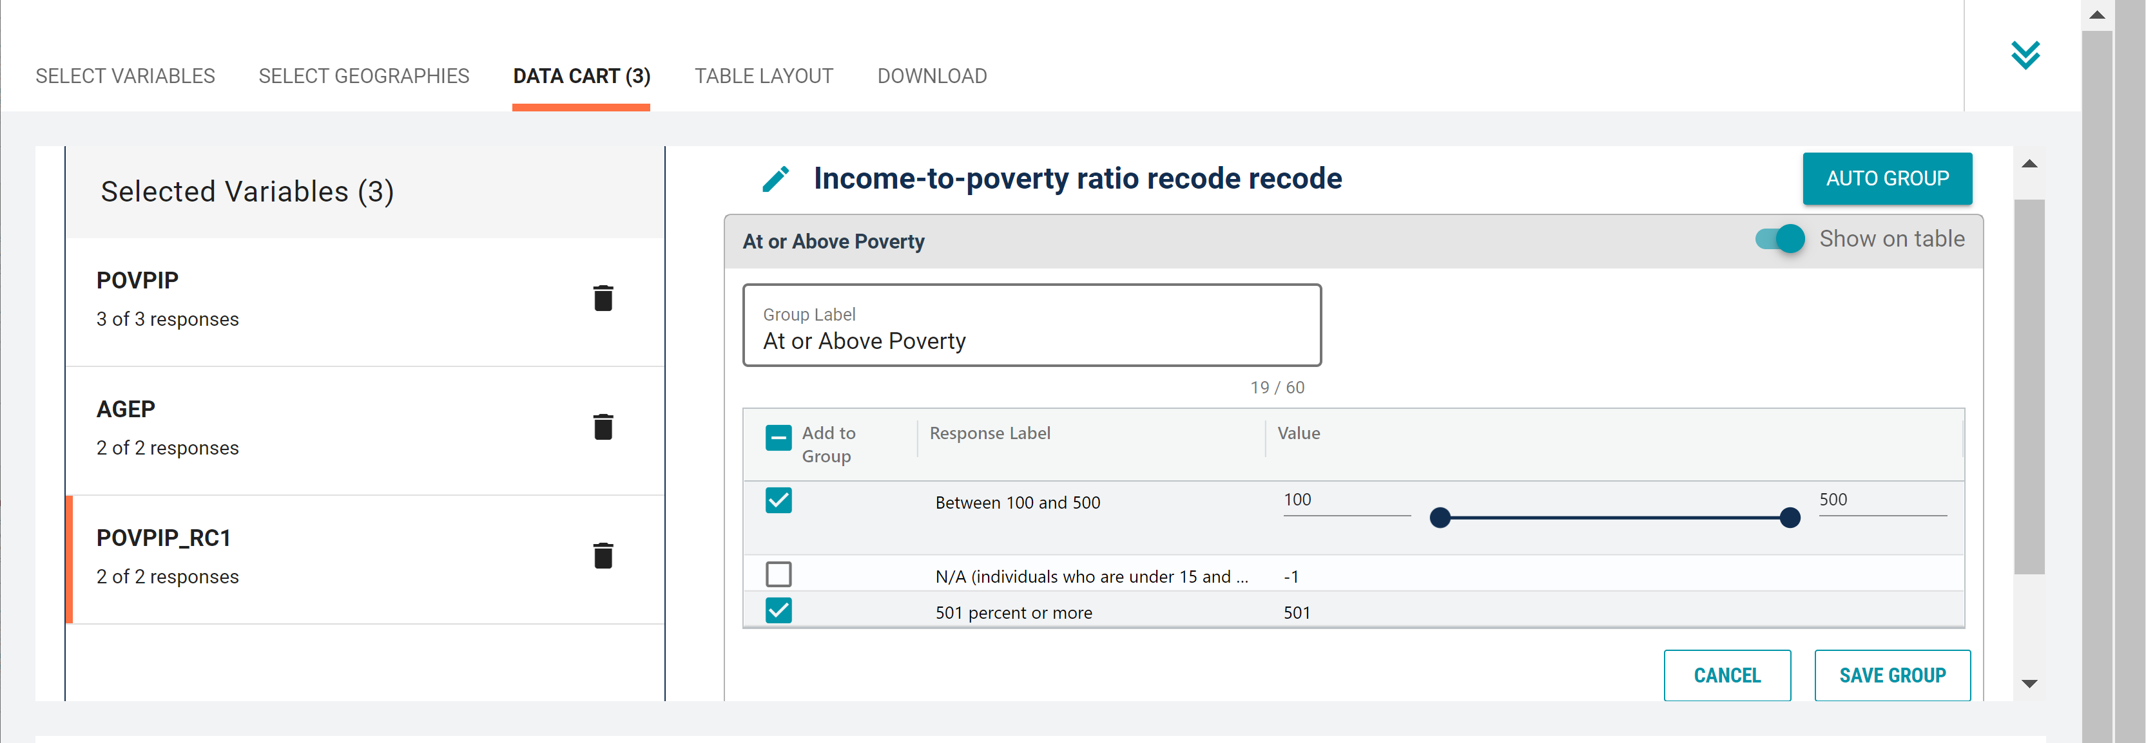
    Demo 2
Categorize (recode) your variable:
  Click into Group label and type a custom label (e.g. At or Above Poverty)
  Check the box next to the relevant response categories for this code:
    Between 100 and 500
    501 percent or more
  Click Save Group
42

Slide 43
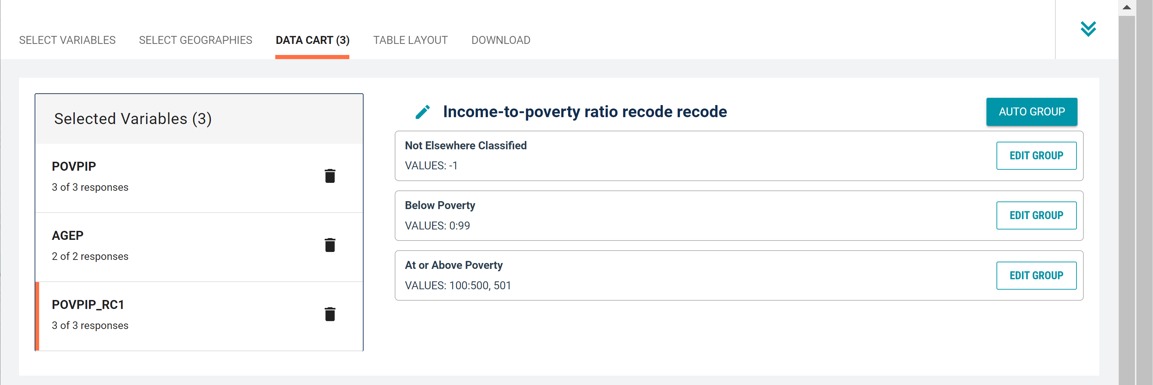
    Demo 2
Categorize (recode) your variable:
  Your second category At or Above Poverty appears in the list
  Click Edit Group for “Not Elsewhere Classified” to edit the label and confirm values
43

Slide 44
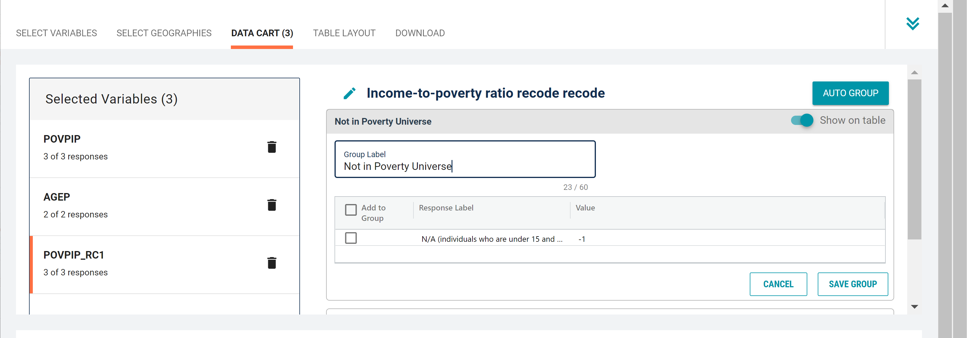
    Demo 2
Categorize (recode) your variable:
  Click into Group Label and rename the category (e.g. Not in Poverty Universe)
  Click Save Group in the lower right
44

Slide 45
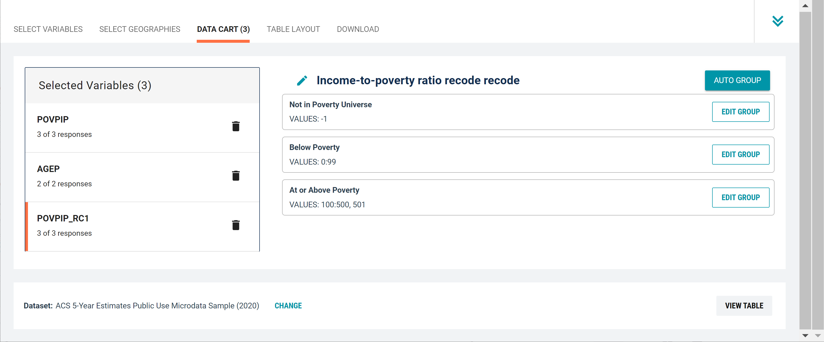
    Demo 3
Confirm poverty categories
  Confirm POVPIP_RC1 categories, labels, and values

Slide 46
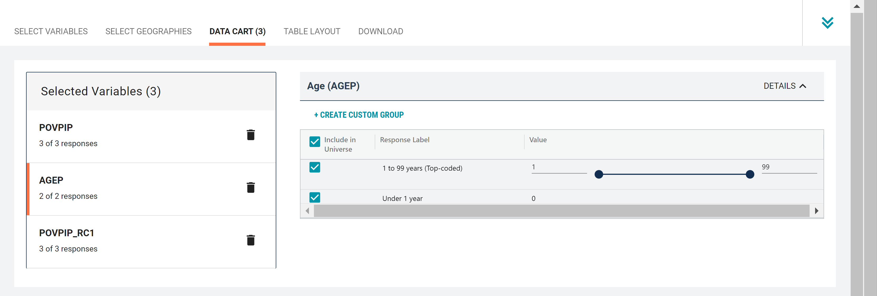
    Demo 3
Categorize (recode) your age variable:
  Click the AGEP variable on the left
  Click Create Custom Group to begin specifying your age categories (e.g. 0, 1, 2,..99)

Slide 47
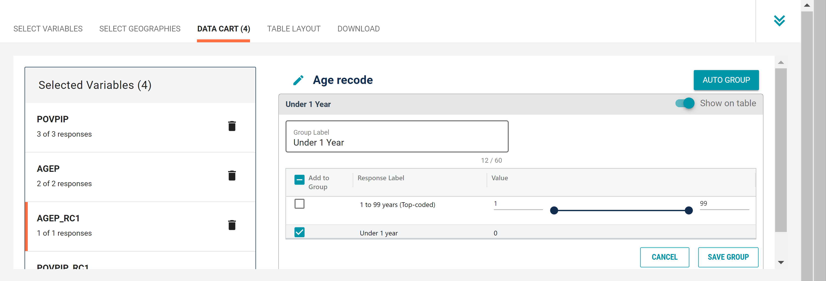
    Demo 3
Categorize (recode) your age variable:
  Click into Group label and type a label for the first category you want to create (e.g. Under 1 year)
  Check the box next to Under 1 Year
  Click Save Group

Slide 48
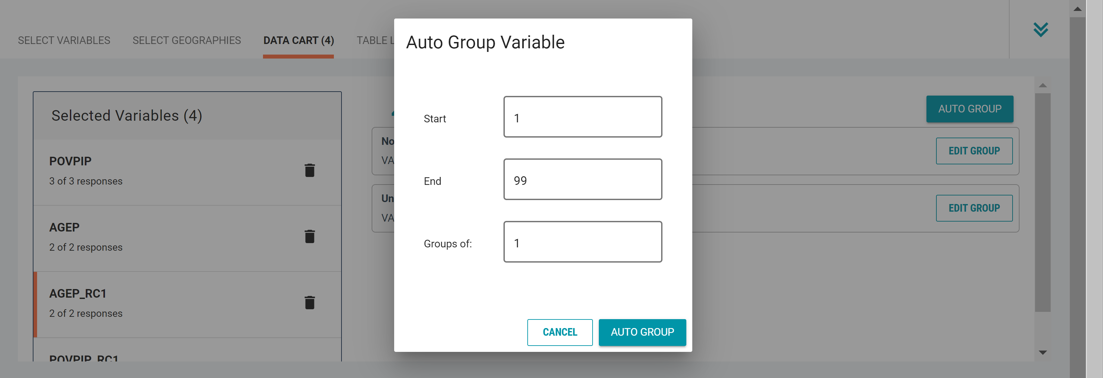
    Demo 3
Categorize (recode) your age variable:
  Click into Auto Group in the upper right
  In the pop-up box, confirm the start and end range and confirm that “Groups of” is set to 1 to get single year of age
  Click Auto Group

Slide 49
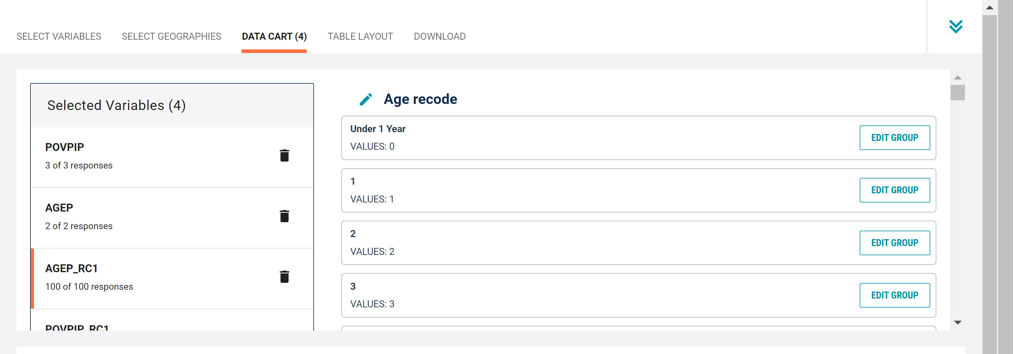
    Demo 3
Categorize (recode) your age variable:
  You have now created categories for single year of age 0, 1, 2, ….99.

Slide 50
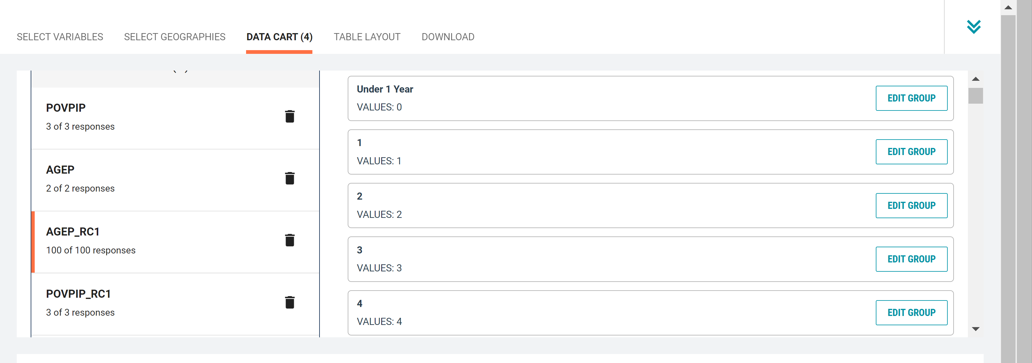
    Demo 3
Confirm variable selections
  Confirm variable selections and click the Table Layout tab

Slide 51
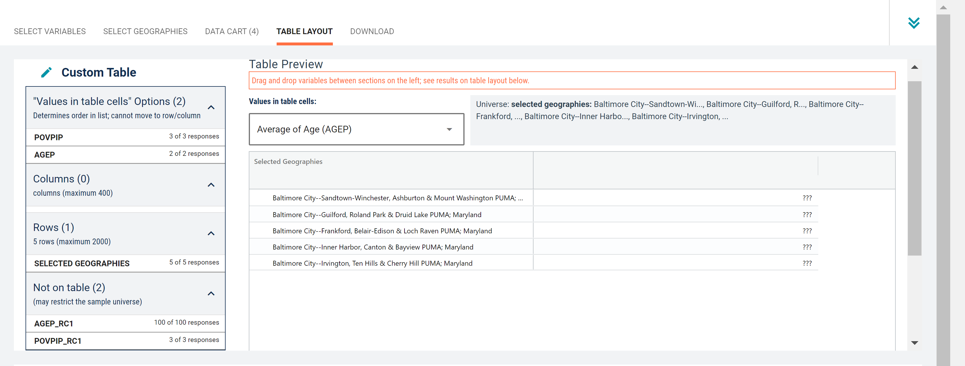
    Demo 2
View variable placement in the default table layout:
  Values in table cells Options – When variables are shown here, you have more options to choose from in the drop-down menu for “Values in table cells”
  Columns/Rows – Variables will be shown in the table. By default, the table is providing data by geography (PUMAs) in the rows.
  Not on Table – Can restrict the universe. By default, A_AGE_RC1 and POVPIP_RC1 are not on the table, and they do not restrict the universe because the recodes included all possible values.
51

Slide 52

    Demo 2
Edit Table Layout:
  Move SELECTED GEOGRAPHIES to Columns: This will add the geographies to the columns
52

Slide 53

    Demo 2
Edit Table Layout:
  Move AGEP_RC1 and POVPIP_RC1 to Rows: This will add these variables to the rows
53

Slide 54

    Demo 2
Choose type of values in table cells
  Change the “Value in table cells” option to Count. This will give you data for the total number of people in each category.
54

Slide 55

    Demo 2
Confirm Table Layout:
  Confirm table layout and click View Table in the lower right
55

Slide 56

    Demo 3
View Table:

Slide 57
Limitations of the Microdata Access Tool
The site does not currently have the functionality to:
Calculate medians, percentages, or margins of error
Show data over time in a single view
Calculate an average over time for monthly CPS datasets
Create new variables from existing variables, including:
  Applying inflation-adjustment variables like ADJINC to dollar values

Slide 58
Benefits of the Microdata Access Tool
Benefits of the Microdata Access Tool:
Create custom tables that provide more topic detail compared to a pre-tabulated table on data.census.gov
Save or download your results easily
No need to purchase or learn complex statistical software

Slide 59

Our Development Depends on YOUR Feedback
Check out data.census.gov and provide comments at census.data@census.gov

Slide 60


Email Updates
Sign up for email updates:
https://public.govdelivery.com/accounts/USCENSUS/signup/15450

Slide 61

Stay Connected
Microdata Access Tool (MDAT) Resources Page:
census.gov/data/what-is-data-census-gov/guidance-for-data-users/how-to-materials-for-using-the-microdata-access.html
Feedback/Data Questions: census.data@census.gov
data.census.gov Training Requests:
ced.cedsci.outreach@census.gov
Notes:
As a reminder, you can access more educational materials on how to use data.census.gov by visiting census.gov/data/what-is-data-census-gov.html

